Slide 1
AQUEOUS CHEMISTRY + HETEROGENEOUS REACTIONS NC A&T Lecture February 15, 2011 Mary Barth barthm@ucar.edu

Slide 2
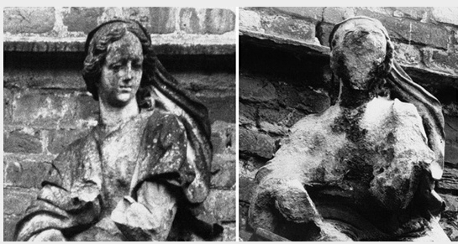
Effects of Acid Rain
How does rain become acidic?

Slide 3
Intro. to Clouds and Cloud Physics
Many different types of clouds
Stratus = low level layer of cloud
Marine stratus is very common
Stratocumulus by
Atacama Desert, Chile

Slide 4
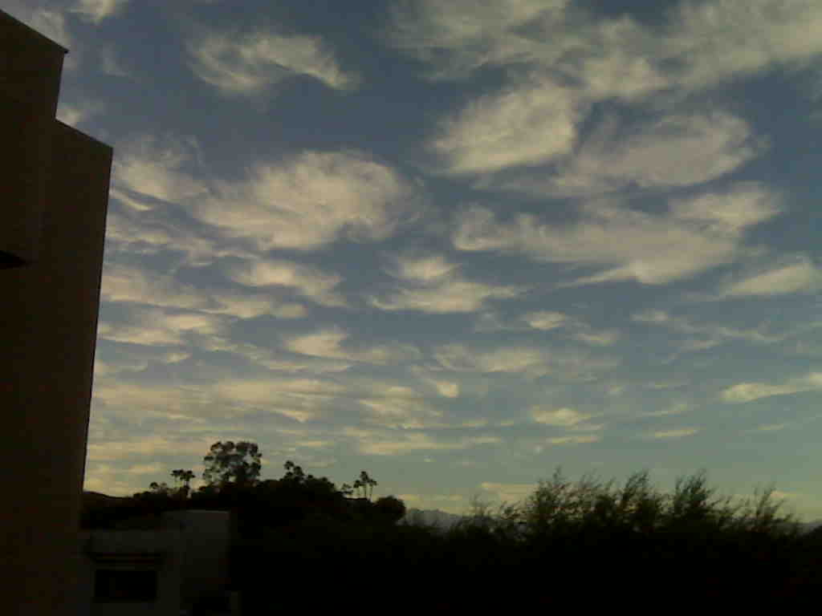
Intro. to Clouds and Cloud Physics
Many different types of clouds
Altostratus and Altocumulus =
middle level clouds

Slide 5
Intro. to Clouds and Cloud Physics
Many different types of clouds
Cirrus = high clouds
Cirrocumulus
Cirrocumulus
Cirrus

Slide 6
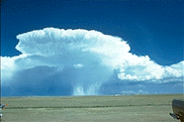
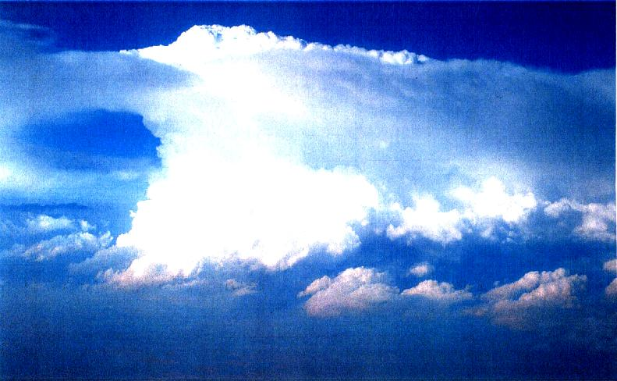
Intro. to Clouds and Cloud Physics
Many different types of clouds
Cumulonimbus a.k.a. thunderstorms
STERAO-1996; From Dye et al. (2000)

Slide 7
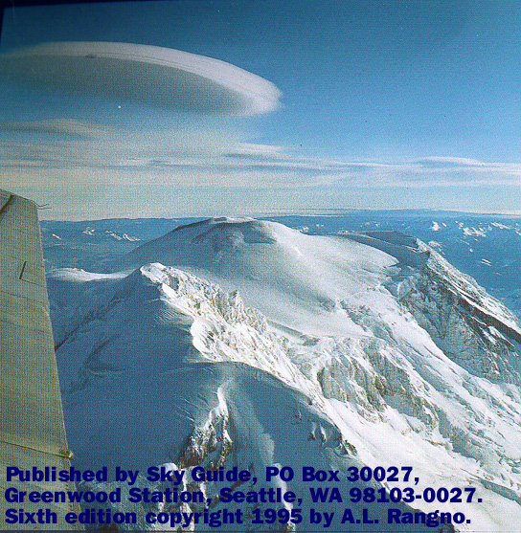
Intro. to Clouds and Cloud Physics
Many different types of clouds
Lenticular clouds a.k.a. pancakes or UFOs
Cumulus humilis a.k.a. fair weather cumulus

Slide 8
Intro. to Clouds and Cloud Physics
Composed of different types of particles
Many different shapes and sizes
Ice crystals
Snow
Graupel or hail
Cloud water
Rain
We are going to focus on the liquid phase and its effects on trace gases

Slide 9
Intro. to Clouds and Cloud Physics
We are going to focus on the liquid phase and its effects on trace gases
Stratocumulus by
Atacama Desert, Chile

Slide 10
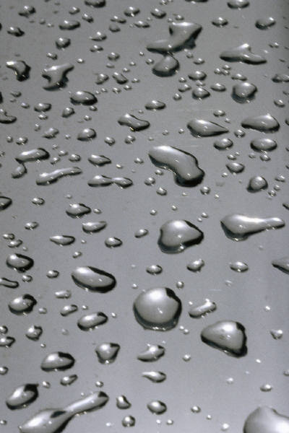
Intro. to Clouds and Cloud Physics
How nature makes a cloud; a 1 minute lesson
Ingredients: water vapor, aerosols, airmass cooling
Rising air cools and expands
Aerosols provide nuclei for water vapor to condense on
Cloud
droplets

Slide 11
Aqueous Phase Chemistry
Chemistry occurring in or on liquid particles (cloud drops, rain drops, fog droplets, aerosols)
Cloud
droplets

Slide 12
Effects of Acid Rain
How does rain become acidic?
Aerosols containing sulfate (SO₄⁼) are cloud condensation nuclei for cloud formation
Aqueous-phase chemistry converts SO₂ → SO₄⁼

Slide 13
Aqueous Phase Chemistry
1. Gas-phase diffusion to drop surface
2. Dissolution into drop
SO₂
oxidant
SO₂ (gas)
SO₂ (aq)
oxidant (aq)
oxidant (gas)
3. Dissociation or ionization
5. Chemical reaction in drop
4. Aqueous-phase diffusion
SO₂ • H₂O
H⁺ + HSO₃⁻
H⁺ + SO₃⁼
HSO₃⁻ + oxidant
SO₄⁼
SO₃⁼ + oxidant
oxidant
HSO₃⁻

Slide 14
Aqueous Phase Chemistry
1. Gas-phase diffusion to drop surface
SO₂
oxidant
For most species, the diffusion processes are faster than the other processes → less important
Will come back to this at end of lecture
4. Aqueous-phase diffusion
oxidant
HSO₃⁻

Slide 15
Aqueous Phase Chemistry
2. Dissolution into drop → Henry’s Law equilibrium
Henry’s Law: Partitioning of species between aqueous and gas phases (for dilute solutions)
SO₂ (gas)
SO₂ (aq)
$SO2\left(g\right)+H2O ↔SO2∙H2O=$H₂SO₃
$$KH= \frac{[H2SO3]}{PSO2}$$
oxidant (aq)
oxidant (gas)
K_{H} = Henry’s Law Constant
Units are mol/L/atm OR M/atm
$$KH\left(T\right)=KH298exp\left(\frac{−∆H}{R}\left(\frac{1}{T}−\frac{1}{298}\right)\right)$$
Note: K_{H}↑ as T↓

Slide 16
Aqueous Phase Chemistry
2. Dissolution into drop → Henry’s Law equilibrium
Some Henry’s Law Constants of Atmospheric Relevance
Chemical Species | Henry’s Law Constant @ 25°C (mol/L/atm)
HNO₃ | 2.1x10⁵
H₂O₂ | 7.5x10⁴
HCHO | 3.5x10³
NH₃ | 57.5
SO₂ | 1.2
O₃ | 0.0113
CO | 9.6x10⁻⁴
SO₂ (gas)
SO₂ (aq)
oxidant (aq)
oxidant (gas)

Slide 17
Aqueous Phase Chemistry
3. Dissociation or ionization
The most fundamental ionization reaction:
H₂O ↔ H⁺ + OH⁻
SO₂ • H₂O
H⁺ + HSO₃⁻
H⁺ + SO₃⁼
Acidity of a Drop: Electroneutrality or charge balance
For pure water [H⁺]=[OH⁻]
pH = -log₁₀[H⁺] → the activity of H⁺
< 7 = acidic
> 7 = basic
7 = neutral

Slide 18
Aqueous Phase Chemistry
3. Dissociation or ionization
$$SO2\left(g\right)+H2O ↔SO2∙H2O KH= \frac{[H2SO3]}{PSO2}$$
SO₂ • H₂O
H⁺ + HSO₃⁻
H⁺ + SO₃⁼
$$H2SO3 ↔{HSO}_{3}^{−}+H+ K1S= \frac{\left[{HSO}_{3}^{−}\right][H^{+}]}{[H2SO3]}$$
$${HSO}_{3}^{−}↔{SO}_{3}^{=}+H+ K2S= \frac{\left[{SO}_{3}^{=}\right][H^{+}]}{[{HSO}_{3}^{−}]}$$
$$[S\left(IV\right)]=\left[H2SO3\right]+\left[{HSO}_{3}^{−}\right]+\left[{SO}_{3}^{=}\right]$$
$$\left[S\left(IV\right)\right]=K_{H}p_{SO2}\left[1+{\frac{K_{1S}}{[H^{+}]}}_{ }+\frac{K_{1S}K_{2S}}{\left[H^{+}\right]2}\right]$$
$$\left[S\left(IV\right)\right]=K_{Heff}p_{SO2}$$
$$K_{Heff}>K_{H}$$
Dissociation in water increases the effective solubility of the gas

Slide 19
Aqueous Phase Chemistry
3. Dissociation or ionization
T = 298 K, p_{air} = 1 atm
SO₂ = 1ppb = 10⁻⁹ mol SO₂/mol air
= 10⁻⁹ atm SO₂/atm air
K_{H} = 1.23 M/atm
K_{1S} = 1.23x10⁻² M
K_{2S} = 6.61x10⁻⁸ M
pH = 5.5 = -log₁₀[H⁺]
[H⁺] = 10^{-5.5} = 3.16x10⁻⁶ M
→
[S(IV)] = 1.23x10⁻⁹ + 4.8x10⁻⁶ + 1.0x10⁻⁷
= 4.9x10⁻⁶
SO₂ • H₂O
H⁺ + HSO₃⁻
H⁺ + SO₃⁼
$$[S\left(IV\right)]=\left[H2SO3\right]+\left[{HSO}_{3}^{−}\right]+\left[{SO}_{3}^{=}\right]$$
$$\left[S\left(IV\right)\right]=K_{H}p_{SO2}\left[1+{\frac{K_{1S}}{[H^{+}]}}_{ }+\frac{K_{1S}K_{2S}}{\left[H^{+}\right]2}\right]$$
$$\left[S\left(IV\right)\right]=K_{Heff}p_{SO2}$$
$$K_{Heff}>K_{H}$$
HSO₃⁻ dominates S(IV) fraction

Slide 20
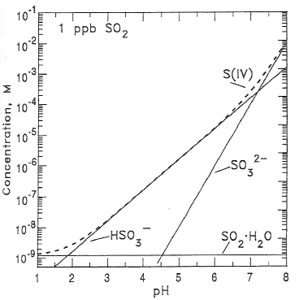
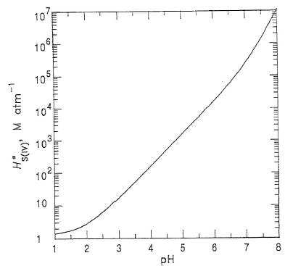
S(IV) Solubility and Composition Depends Strongly on pH
$$\left[S\left(IV\right)\right]=K_{H}p_{SO2}\left[1+{\frac{K_{1S}}{[H^{+}]}}_{ }+\frac{K_{1S}K_{2S}}{\left[H^{+}\right]2}\right] \left[S\left(IV\right)\right]=K_{Heff}p_{SO2}$$
[Seinfeld & Pandis]

Slide 21
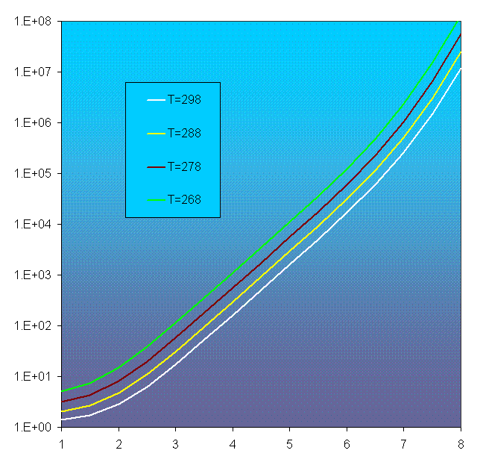
Importance of Temperature on effective Henry’s Law const
268 K
278 K
Heff
More soluble at colder temperatures
Super-cooled cloud water exists at temperatures as cold as 235 K
288 K
298 K
pH

Slide 22
Aqueous Phase Chemistry
Acidity of Drop
Electroneutrality or charge balance
[H⁺] = [OH⁻] + [HSO₃⁻] + 2[SO₃⁼]
SO₂ • H₂O
H⁺ + HSO₃⁻
H⁺ + SO₃⁼
Include contribution from CCN
H₂SO₄, NH₄HSO₄, or (NH₄)₂SO₄
[NH₄⁺] + [H⁺] = [OH⁻] + [HSO₃⁻] + 2[SO₃⁼] + 2[SO₄⁼]
pH = -log[H⁺] → the activity of H⁺
< 7 = acidic
> 7 = basic
7 = neutral

Slide 23
Aqueous Phase Chemistry
Acidity of Drop
What about CO₂ ?
[NH₄⁺] + [H⁺] = [OH⁻] + [HSO₃⁻] + 2[SO₃⁼] + 2[SO₄⁼]
+ [HCO₃⁻] + 2[CO₃⁼]
CO₂
CO₂ • H₂O
H⁺ + HCO₃⁻
H⁺ + CO₃⁼
If no SO₂, NH₃, sulfate, then
[H⁺] = [OH⁻] + [HCO₃⁻] + 2[CO₃⁼]
→ Natural acidity of rain
pH = -log[H⁺] → the activity of H⁺
< 7 = acidic
> 7 = basic
7 = neutral

Slide 24
Natural Acidity of Rain
Following book:
[H⁺] = [OH⁻] + [HCO₃⁻] + 2[CO₃⁼]
Page 147 of Brasseur, Orlando, Tyndall
CO₂ (g) = 360 ppm, T = 298, p = 1 atm
$[CO2∙H2O$] = K_{H} p_{CO2}
= 3.4x10⁻² (360x10⁻⁶)
= 1.2x10⁻⁵ M
${[HCO}_{3}^{−}][H+$] = 4.5x10⁻⁷ (1.2x10⁻⁵)
= 5.5x10⁻¹² M²
[OH⁻] = 1x10⁻¹⁴ (negligible)
And assume ${HCO}_{3}^{−}$ more predominant than ${CO}_{3}^{=}$
[H⁺] = [HCO₃⁻]
[H⁺] = $\sqrt{{\text{5.5}\text{x}\text{10}}^{\text{−12}}}={2.3x10}^{−6}$
pH = -log₁₀$[H+$] = 5.6
${CO}_{3}^{=}$ << ${HCO}_{3}^{−}$ at pH < 7
CO₂
CO₂ • H₂O
H⁺ + HCO₃⁻
H⁺ + CO₃⁼
$$CO2\left(g\right)+H2O ↔CO2∙H2O KH= \frac{[H2CO3]}{PCO2}$$
$$H2CO3 ↔{HCO}_{3}^{−}+H+ K1C= \frac{\left[{HCO}_{3}^{−}\right][H^{+}]}{[H2CO3]}$$
$${HCO}_{3}^{−}↔{CO}_{3}^{=}+H+ K2C= \frac{\left[{CO}_{3}^{=}\right][H^{+}]}{[{HCO}_{3}^{−}]}$$

Slide 25
Natural Acidity of Rain
Without assumptions:
[H⁺] = [OH⁻] + [HCO₃⁻] + 2[CO₃⁼]
Page 147 of Brasseur, Orlando, Tyndall
CO₂
CO₂ • H₂O
H⁺ + HCO₃⁻
H⁺ + CO₃⁼
$$\left[H^{+}\right]=\left[{OH}^{−}\right]+\frac{K_{1C}K_{H}p_{CO2}}{\left[H^{+}\right]}+2\frac{K_{2C}K_{1C}K_{H}p_{CO2}}{{\left[H^{+}\right]}^{2}}$$
${\left[H^{+}\right]}^{3}−{ \left(K_{w}+{K_{1C}K}_{H}p_{CO2}\right)}_{ }\left[H^{+}\right]$ - 2$K_{2C}K_{1C}K_{H}p_{CO2}$ = 0
Polynomial! Can either get computer/calculator to estimate OR iterate: guess a value for $\left[H^{+}\right]$ and calculate result.
For pH = -log₁₀$[H+$] = 5.6
1.585x10⁻¹⁷ – 1.386x10⁻¹⁷ – 5.18x10⁻²² = 1.99x10⁻¹⁸
Note: ${CO}_{3}^{=}$ << ${HCO}_{3}^{−}$
$${\left[H^{+}\right]}^{2}={ \left(K_{w}+{K_{1C}K}_{H}p_{CO2}\right)}_{ }$$
[H⁺] = [HCO₃⁻] assumption is valid
CO₂ (g) = 360 ppm
T = 298, p = 1 atm
$$KH= \frac{[H2CO3]}{PCO2}$$
$$K1C= \frac{\left[{HCO}_{3}^{−}\right][H^{+}]}{[H2CO3]}$$
$$K2C= \frac{\left[{CO}_{3}^{=}\right][H^{+}]}{[{HCO}_{3}^{−}]}$$

Slide 26
Phase Ratio between Gas and Liquid
Phase ratio = amount of gas in a cloud volume that resides in aqueous phase relative to the gas phase
$$Px = \frac{[aqueous]}{[gas]}$$
P_{x} = 1 → half of the gas is dissolved in drops and half resides in cloud interstitial gas phase
$$Px =L K_{Heff} R T$$
L = liquid water content (cm³ H₂O/cm³ air)
 | 268 K | 293 K
HNO₃ | 1.6x10⁹ | 6.4x10⁶
H₂O₂ | 6.4 | 0.8
SO₂ | 0.072 | 0.014
CO₂ | 6.3x10⁻⁷ | 2.9x10⁻⁷
O₃ | 1.9x10⁻⁷ | 9.1x10⁻⁸

Slide 27
Aqueous Phase Chemistry
1. Gas-phase diffusion to drop surface
2. Dissolution into drop
SO₂
√
oxidant
SO₂ (gas)
SO₂ (aq)
oxidant (aq)
oxidant (gas)
3. Dissociation or ionization
5. Chemical reaction in drop
4. Aqueous-phase diffusion
SO₂ • H₂O
H⁺ + HSO₃⁻
H⁺ + SO₃⁼
HSO₃⁻ + oxidant
SO₄⁼
SO₃⁼ + oxidant
√
oxidant
HSO₃⁻

Slide 29
What type of cloud is shown?
Cirrus = high clouds
Cirrocumulus
Cirrocumulus
Cirrus

Slide 30
Aqueous Phase Chemistry
5. Chemical reaction in drop
What oxidants react with S(IV) ?
H₂O₂
O₃
HSO₃⁻ + oxidant
SO₄⁼
SO₃⁼ + oxidant
H₂O₂
HSO₃⁻(aq) + H₂O₂(aq) ↔ SO₂OOH⁻(aq)
SO₂OOH⁻(aq) + H⁺(aq) → H₂SO₄(aq)
Units: $\frac{mol {SO}_{4}^{=}}{L H2O s}$
k₁ = 7.45x10⁷ M⁻² s⁻¹ at T=298K
K = 13 M⁻¹
→ To compare with gas-phase rates, need to use L to convert

Slide 31
Aqueous Phase Chemistry
5. Chemical reaction in drop
What oxidants react with S(IV) ?
H₂O₂
O₃
HSO₃⁻ + oxidant
SO₄⁼
SO₃⁼ + oxidant
O₃
HSO₃⁻(aq) + O₃(aq) ↔ SO₂OOH⁻(aq)
SO₃⁼(aq) + O₃ (aq) → SO₄⁼(aq)
$$\frac{d[{SO}_{4}^{=}]}{dt}=k1\left[H{SO}_{3}^{−}\right]\left[O_{3}\right]+k2\left[{SO}_{3}^{=}\right][O_{3}]$$
Units: $\frac{mol {SO}_{4}^{=}}{L H2O s}$
k₁ = 3.2x10⁵ M⁻¹ s⁻¹ at T=298K
k₂ = 1.0x10⁹ M⁻¹ s⁻¹ at T=298 K

Slide 32
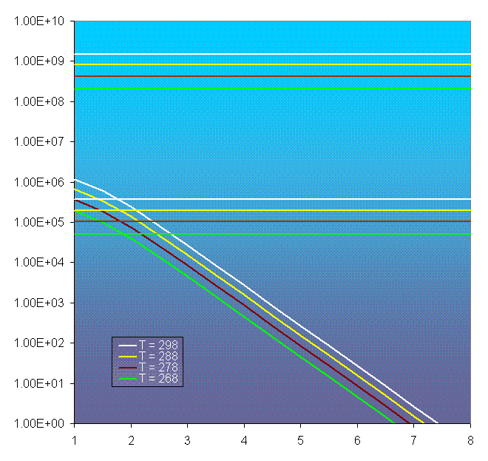
Aqueous Phase Chemistry
Rate constants for S(IV) oxidation by H₂O₂ and O₃
k_O₃ + SO₃⁼
The rate constants are generally greater at higher temperatures
k (268 K) < k (298 K)
298 K
288 K
k_O₃ + HSO₃⁻
278 K
268 K
k_H₂O₂

Slide 33
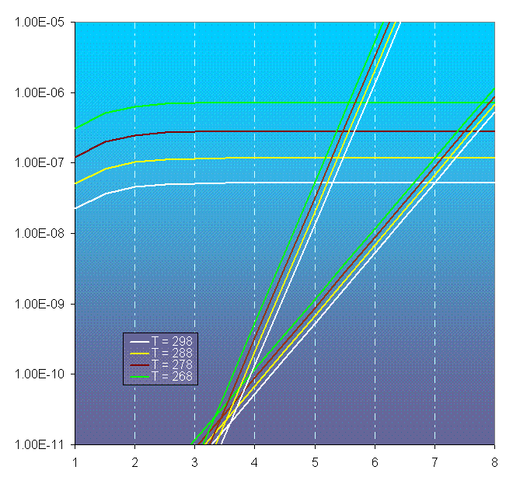
Aqueous Phase Chemistry
Reaction rates for S(IV) oxidation by H₂O₂ and O₃
Are rates of oxidation faster or slower at colder temperatures?
Recall
K_{H} (268 K) > K_{H} (298 K)
But
k (268 K) < k (298 K)
→ Colder temperatures, faster rates!
H2O2
268 K
278 K
288 K
298 K
O3 + SO3=
O3 + HSO3-
SO₂ = 2 ppbv
H₂O₂ = 1 ppbv
O₃ = 50 ppbv

Slide 34
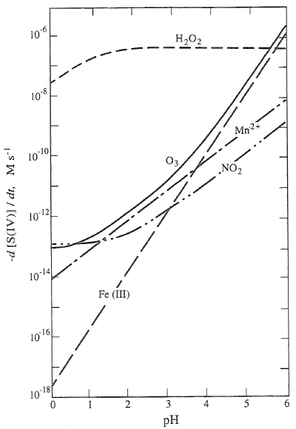
Aqueous Phase Chemistry
5. Chemical reaction in drop
Comparison of S(IV) oxidation pathways
HSO₃⁻ + oxidant
SO₄⁼
SO₃⁼ + oxidant
Rate of sulfate production
Oxidation by H₂O₂ is pH independent for pH>1.5
Oxidation by H₂O₂ dominates for pH < 5
Oxidation of SO₃⁼ by O₃ is fast and important at pH > 5.5
Oxidation by oxygen catalyzed by Fe(III), Mn(II) can happen by is smaller magnitude
SO2 (g) = 5 ppbv
H2O2 (g) = 1 ppbv
O3 (g) = 50 ppbv
Fe(III) = Mn(II) = 0.03μM
T = 298 K
(Seinfeld and Pandis, 2006)

Slide 35
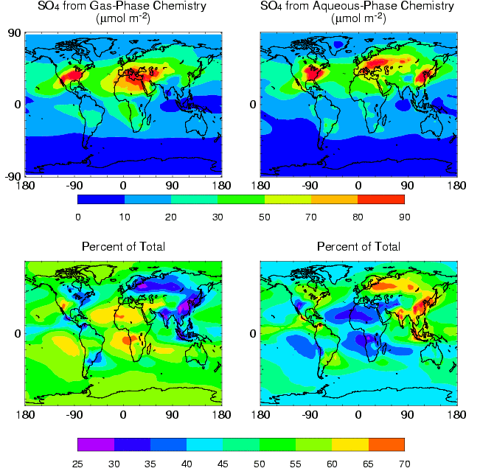
Aqueous Phase Chemistry
Importance of aqueous chemistry on global scale
Aerosols play an important role in the energy budget of the atmosphere by either scattering or absorbing solar radiation.
→ Results from global climate model simulations show that 50-55% of sulfate in troposphere is from aqueous-phase chemistry
Barth et al., 2000

Slide 36
Effects of Acid Rain
How does rain become acidic?
Aerosols containing sulfate (SO₄⁼) are cloud condensation nuclei for cloud formation
Aqueous-phase chemistry converts SO₂ → SO₄⁼
Other acids contribute too (HNO₃, HCOOH, and other organic acids)

Slide 37
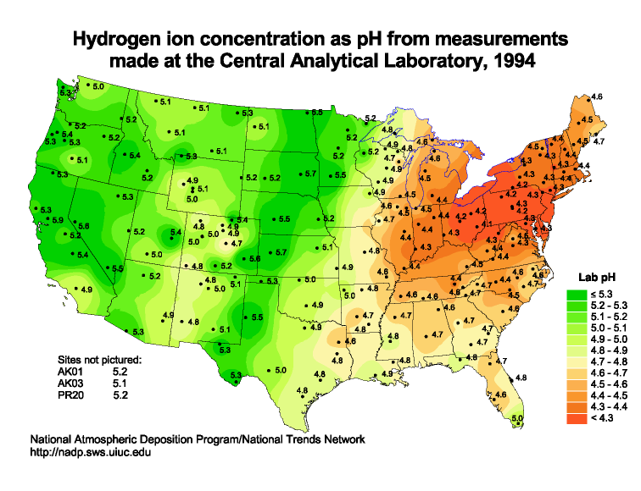
Effects of Acid Rain
pH=4.2
pH=4.5

Slide 38
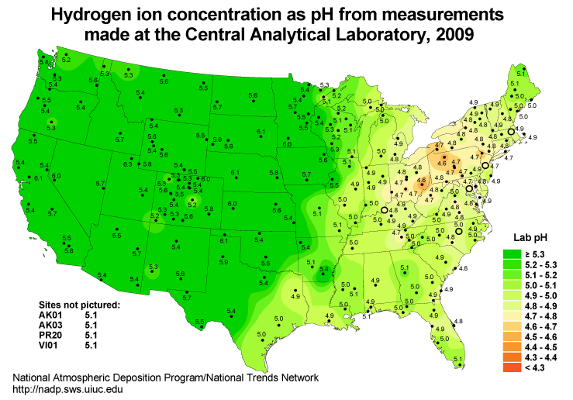
Effects of Acid Rain
pH=4.6
pH=5.0

Slide 39
Aqueous Phase Chemistry
5. Chemical reaction in drop
S(IV) chemistry is not only aqueous chemistry going on!
CH₂O
CH₂(OH)₂+ OH
CO₂
HCOO⁻ + OH
HCOOH + OH
CH₂O(aq) + H₂O(l) → CH₂(OH)₂
CH₂(OH)₂ + OH → HCOOH
HCOOH $↔$ HCOO⁻ + H⁺
HCOOH + OH → CO₂ + HO₂
HCOO⁻ + OH → CO₂ + HO₂
H₂O₂ + hv → 2 OH
HO₂ ↔ O₂⁻
O₃ + O₂⁻ → OH

Slide 40
Aqueous Phase Chemistry
5. Chemical reaction in drop
Formaldehyde chemistry is quite active in aqueous phase.
CH₂O
CH₂(OH)₂+ OH
CO₂
HCOO⁻ + OH
HCOOH + OH
Photochemical box model simulation –
gas + aqueous concentration
0.0 g/m³
0.3 g/m³
L = 0.6 g/m³
What about other organic aldehydes?
Exposed to cloud

Slide 41
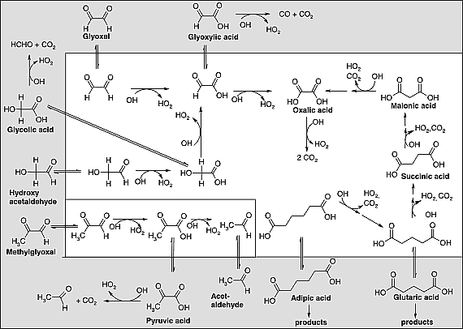
Aqueous Phase Chemistry
5. Chemical reaction in drop
Recent laboratory work has paved the way for assessing the importance of organic aqueous chemistry (Carlton, Turpin; Herrmann ) and modeling work by B. Ervens (2004)
Organic aqueous chemistry is a source of secondary organic aerosol
Gas phase
Aqueous
Low volatility species that will be part of CCN when drops evaporate:
Oxalic acid
Pyruvic acid
Ervens et al. (2004) JBR

Slide 42
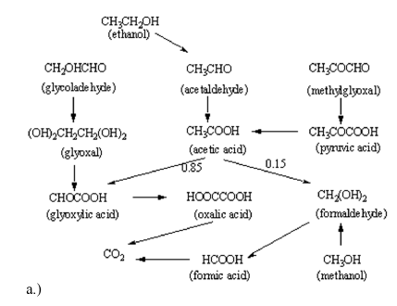
Aqueous Phase Chemistry
5. Chemical reaction in drop
Now at the point where the organic aqueous chemistry, or a parameterization of the chemistry, needs to be included in regional-scale and global-scale models.
Shown is a parameterization developed for the CMAQ model
Organic aqueous chemistry is a source of secondary organic aerosol
Chen et al. (2007) ACP

Slide 43
Aqueous Phase Chemistry
1. Gas-phase diffusion to drop surface
2. Dissolution into drop
SO₂
√
oxidant
SO₂ (gas)
SO₂ (aq)
oxidant (aq)
oxidant (gas)
3. Dissociation or ionization
5. Chemical reaction in drop
4. Aqueous-phase diffusion
√
SO₂ • H₂O
H⁺ + HSO₃⁻
H⁺ + SO₃⁼
HSO₃⁻ + oxidant
SO₄⁼
SO₃⁼ + oxidant
√
oxidant
HSO₃⁻

Slide 44
Aqueous Phase Chemistry
1. Gas-phase diffusion to drop surface
SO₂
oxidant
For most species, the diffusion processes are faster than the other processes → less important
When is this important?
4. Aqueous-phase diffusion
oxidant
HSO₃⁻

Slide 45
Aqueous Phase Chemistry
1. Gas-phase diffusion to drop surface
Gas phase diffusion
$$4πa_{D}D_{g}N$$
$$L=\frac{4}{3}πa_{D}^{3}N$$
→ $\frac{3D_{g}L}{a_{D}^{2}}$ (sec⁻¹)
Timescale: $τ_{dg}$= $\frac{a_{D}^{2}}{3D_{g}L}$
Diffusion across interface
$$\frac{3cαL}{4a_{D}}$$
c = speed of sound
= accommodation coefficient
Timescale: $τ_{i}$= $\frac{4a_{D}^{ }}{3cαL}$
SO₂
oxidant
$$a_{D}$$
Typical values:
τ_{dg} = seconds or less
τ_{i} = seconds or less

Slide 46
Aqueous Phase Chemistry
4. Aqueous-phase diffusion
Aqueous phase diffusion
Timescale: $τ_{da}$= $\frac{a_{D}^{2}}{π^{2}D_{a}}$
$D_{a}$ = 2x10⁻⁹ m²/s
$τ_{da}$= 0.005 s
→ Much faster than chemical reactions in the aqueous phase
oxidant
HSO₃⁻
$$a_{D}$$

Slide 47
Aqueous Phase Chemistry
1. Gas-phase diffusion to drop surface
Rate into drop
$$\frac{dC_{liq}}{dt}={k_{t}C}_{gas}$$
$$k_{t}= \left[\frac{1}{τ_{dg}+τ_{i}}\right]$$
Rate out of drop
$$\frac{dC_{gas}}{dt}={\frac{k_{t}}{K_{Heff}RTL}C}_{liq}$$
When rate in = rate out
$${k_{t}C}_{gas}={\frac{k_{t}}{K_{Heff}RTL}C}_{liq}$$
$\frac{C_{liq}}{C_{gas}}=K_{Heff}RTL$ = Phase Ratio
SO₂
oxidant
$$a_{D}$$
$τ_{dg}$= $\frac{a_{D}^{2}}{3D_{g}L}$
$τ_{i}$= $\frac{4a_{D}^{ }}{3cαL}$

Slide 48
Heterogeneous Reactions
Reaction between two species of different phases
N₂O₅
N₂O₅(g) + H₂O(l) → 2 HNO₃
$$\frac{d{HNO}_{3}}{dt}=2{k_{t}N_{2}O}_{5}(gas)$$
$$a_{D}$$
Reaction Rate controlled by diffusivity into drop
The accommodation or uptake coefficient becomes the important parameter
Heterogeneous reactions also occur in the stratosphere on sulfate aerosols and polar stratospheric clouds

Slide 49
Aqueous Phase Chemistry
1. Gas-phase diffusion to drop surface
Size matters!
$D_{g}$=10⁻⁵ m²/s ; α = 0.01
$L$=0.5 g/m³ ; c = 300 m/s ;
N₂O₅
$$a_{D}$$
Faster rate for smaller drops
$a_{D}^{ }$=10 μm cloud drop
$τ_{dg}$=6.667 s $τ_{i}$=8.889 s
k_{t} = 0.0643 / s
Rate into drop
$$\frac{dC_{liq}}{dt}={k_{t}C}_{gas}$$
$$k_{t}= \left[\frac{1}{τ_{dg}+τ_{i}}\right]$$
$a_{D}^{ }$=100 μm rain drop
$τ_{dg}$=666.7 s $τ_{i}$=88.89 s
k_{t} = 0.0013 / s
$τ_{dg}$= $\frac{a_{D}^{2}}{3D_{g}L} τ_{i}$= $\frac{4a_{D}^{ }}{3cαL}$

Slide 50
Aqueous Phase Chemistry
1. Gas-phase diffusion to drop surface
2. Dissolution into drop
SO₂
√
√
oxidant
SO₂ (gas)
SO₂ (aq)
oxidant (aq)
oxidant (gas)
3. Dissociation or ionization
5. Chemical reaction in drop
4. Aqueous-phase diffusion
√
SO₂ • H₂O
H⁺ + HSO₃⁻
H⁺ + SO₃⁼
√
HSO₃⁻ + oxidant
SO₄⁼
SO₃⁼ + oxidant
√
oxidant
HSO₃⁻

Slide 51
Aqueous Phase Chemistry
Important factors for aqueous chemistry
Liquid water content
pH = acidity of drops
Size of drops – not just between cloud and rain drops, but also between different cloud drops
N₂O₅
$$a_{D}$$

Slide 52
Clouds and Chemistry
Aqueous phase reactions
Separation of species (e.g. HO₂ → drops, which limits NO + HO₂ gas-phase reaction)
Photolysis rates are altered by scattering
Role of ice on dissolved species
Scavenging of species leading to rain out (acid rain)
Lightning-generated nitrogen oxides
Transport of boundary layer air to free troposphere

