Slide 1

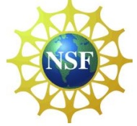
ATMOSPHERIC CHEMISTRY
OF ORGANIC COMPOUNDS
Lecture for NC A&T (part 1)
March 9, 2011
Geoff Tyndall tyndall@ucar.edu

Slide 2
Organics in the Atmosphere
Some definitions
VOC Volatile Organic Compounds
Hydrocarbons – just HYDROgen and CARBON
Oxygenates – alcohols, aldehydes, ketones…
Others:
  sulfides, sulfates
  nitrates, amines
  Chlorides, bromides…

Slide 3
Why do we study VOCs
Important for ozone formation
Air quality (local and regional)
  Local smog
  PAN (transport of nitrogen)
Particle formation (haze, health, climate…)

Slide 4
Where are VOCs important
Just About Everywhere!
Cities (high emissions from cars, factories…)
Forests (high emissions from trees)
Even in remote areas
Polar regions – Arctic haze
Over oceans
So, we need to study chemistry over a range of conditions

Slide 5
Atmospheric Abundance
Depends on:
↑ Emission rate
↑ Production rate in the atmosphere
↑ Transport from a source region
↓Removal
(can either be permanent or conversion)

Slide 6
What kinds of compounds?
Characterized by Functional Groups
  e.g. double bonds, hydroxyl, nitrate, etc
The presence of functional groups affects their chemistry (and hence lifetime)
Also affects solubility
And sampling/detection capabilities
  Sticky compounds less easy to handle
  Opens up different detection/analysis schemes

Slide 7
Alkanes
No functional groups
Just saturated C-C and C-H bonds
General formula C_{n}H_{2n+2}
Methane (CH₄) Ethane (C₂H₆) Propane (C₃H₈)
up to hexadecane (C₁₆H₃₄) and beyond!
Can also be branched (isomers)
Moderately reactive

Slide 8
Branched Hydrocarbons
Isobutane
CH₃CH(CH₃)₂
Isopentane
CH₃CH₂CH(CH₃)₂
2,2,4-trimethyl pentane “iso-octane”
CH₃C(CH₃)₂CH₂CH(CH₃)₂

Slide 9
Alkenes
Contain one double bond
General formula C_{n}H_{2n}
Ethene (C₂H₄) Propene (C₃H₆)…
Again, can also be branched
e.g. 2-methyl-1-pentene
Much more reactive
give 2 small products

Slide 10
Dienes
Contain two double bonds
Two important atmospheric dienes
Butadiene – anthropogenic
C₄H₆
Isoprene – biogenic
C₅H₈
Very reactive

Slide 11
Terpenes
Mostly biogenic molecules
Typically contain one or more rings and one or more double bonds
Highly reactive
High potential for making particles
Very reactive – large products

Slide 12
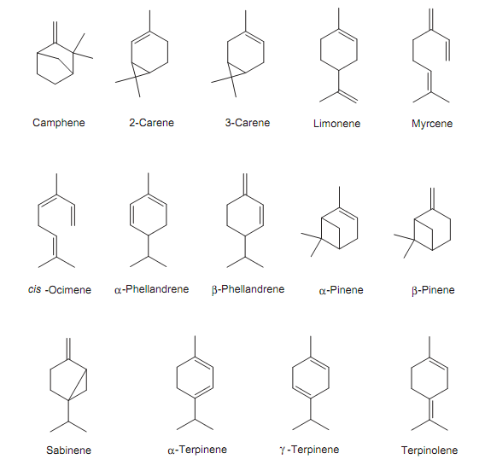
Examples of Monoterpenes
Natural
Products
From Plants
And Trees
C₁₀H₁₆
Atkinson &
Arey, 2003

Slide 13
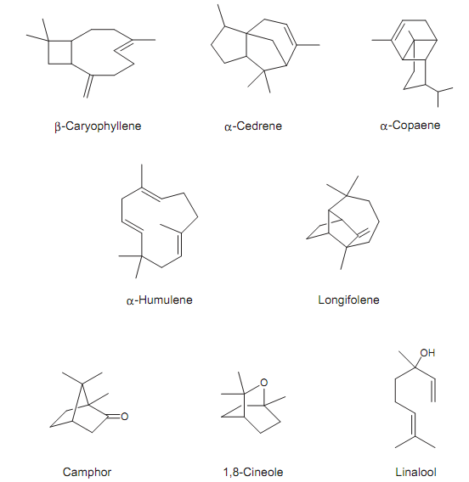
Examples of Sesquiterpenes
Natural
Products
From Plants
And Trees
C₁₅H₂₄
Atkinson &
Arey, 2003

Slide 14
Aromatics
Characterized by ring structure
Highly unsaturated (aromatic benzene ring)
Mostly fuel-related
Benzene is simplest, add on extra groups
→ toluene, xylenes, trimethylbenzenes
Collectively BTEX
Very reactive

Slide 15
Examples of Aromatics
Benzene
Toluene
p-Xylene
p-Cresol

Slide 16
Oxygenates
Often oxidation products of other (simpler) compounds
Also emitted naturally
Can be saturated or unsaturated; simple or multifunctional
Also tend to have higher reactivity than “parent”

Slide 17
Alcohols – contain -OH
Methanol CH₃OH
Ethanol C₂H₅OH
Methyl butenol
  (2-methyl-3-buten-2-ol)
  “isoprene hydrate”
  Emission from certain pine/spruce trees

Slide 18
Carbonyl Compounds
>C=O
Formaldehyde (methanal) HCHO
Acetaldehyde (ethanal) CH₃CHO
Propionaldehyde (propanal) C₂H₅CHO
Acetone (propanone) CH₃C(O)CH₃
Methyl Ethyl Ketone (butanone)
CH₃C(O)CH₂CH₃

Slide 19
Can also get multi/mixed functional cpds
Methacrolein 2-methyl-propenal
Methyl Vinyl Ketone 3-butene-2-one
Glycolaldehyde (2-hydroxyethanal)
HOCH₂CHO
All formed from isoprene oxidation

Slide 20
More multifunctional compounds
Glyoxal HC(O)-C(O)H
Methylglyoxal CH3C(O)CHO
Acids:
Formic acid HC(O)OH
Acetic acid CH₃C(O)OH
Formation pathways for acids are NOT well understood

Slide 21
Cpds containing Other Atoms
Nitrogen
  Nitrates (organic nitrates, PANs)
  Nitriles (HCN, CH₃CN)
  Emitted from fires
  Amines (ammonia derivatives)
  CH₃NH₂, (CH₃)₂NH
  emitted from feedlots
  may be involved in particle formation

Slide 22
Sulfur
Dimethyl sulfide CH₃SCH₃
Emitted by plankton in ocean
Halogens (fluorine, chlorine, bromine, iodine)
Many compounds, some natural, others anthropogenic
CH₃Cl, CH₃Br, CH₃I…
CF₂Cl₂, CF₃CFH₂…

Slide 23
Emissions
Anthropogenic Hydrocarbons
  Thought to be 100-150 Tera gram per year
  NB: 1 Tg = 10¹² gram = 1 Megaton
Biogenic Hydrocarbons
  Isoprene 500-700 Teragram
  Terpenes 100-150 Teragram
Oxygenates – source unknown, but large

Slide 24
Emissions of other compounds may be low, but important in specific regions
e.g. Dimethyl sulfide
Emitted over oceans
Maybe 1-2 Tg per year
Source of sulfur to marine atmosphere
Can lead to sulfuric acid, and hence clouds
climate feedback ?

Slide 25
Typical Abundances
CH₄ around 1.7 ppm (5x10¹³ molec cm⁻³)
Fairly large emissions – long lifetime
Isoprene several ppb in forest (2-10)x10¹⁰
Large emissions – short lifetime
Formaldehyde hundreds of ppt to 1 ppb
Produced photochemically… local balance

Slide 26
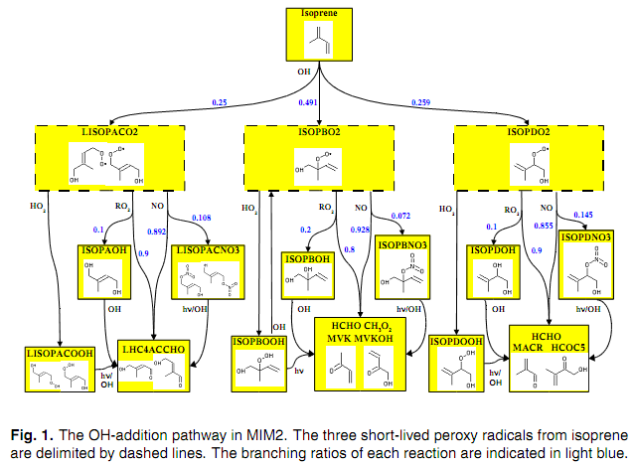
Oxidation Schemes – Isoprene
D. Taraborrelli et al.

Slide 27
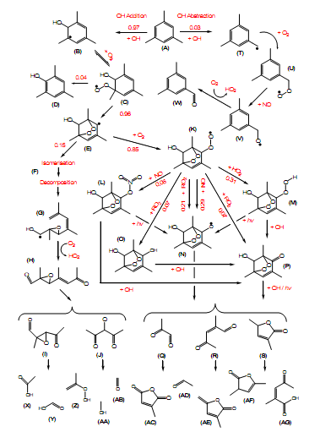
1,3,5-trimethylbenzene
K. Wyche et al.

Slide 28
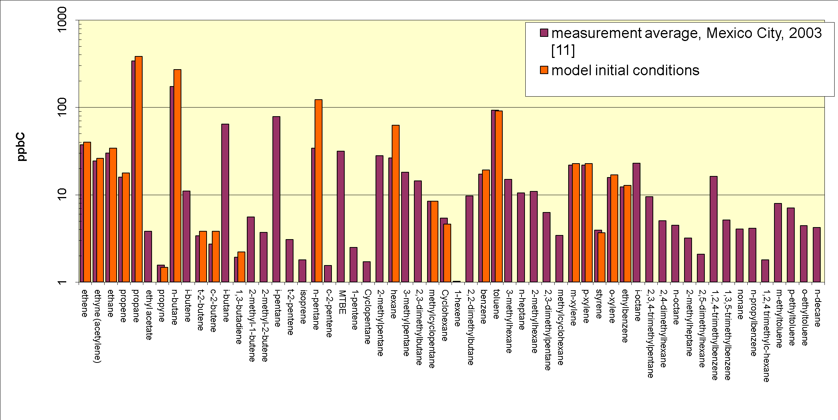
Impacts: case study Mexico City
From Lee-Taylor et al.

Slide 29
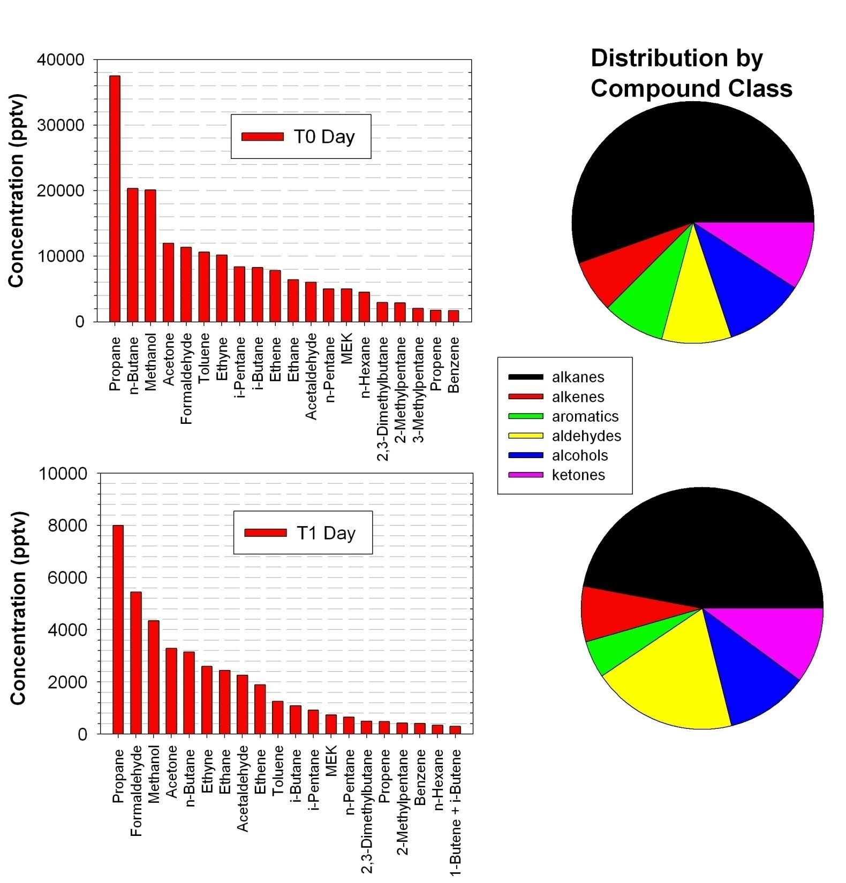
The top 20 compounds measured at T0 (top panel) and T1 (lower panel) in terms of mixing ratios between 9:00 and 18:00 local time averaged over the month of March, 2006. Shown to the right of each bar graph is a breakdown, for T0 and T1, respectively, of all of the species measured in terms of the sums of the mixing ratios for each compound class.

Slide 30
VOC Abundance and Reactivity in Mexico City C-130 overflights
~60% of reactivity
from aldehydes
high methanol
Apel et al., * designates UCI measurement
Notes:
Methanol quite large although globally should be mostly biogenic

Slide 31
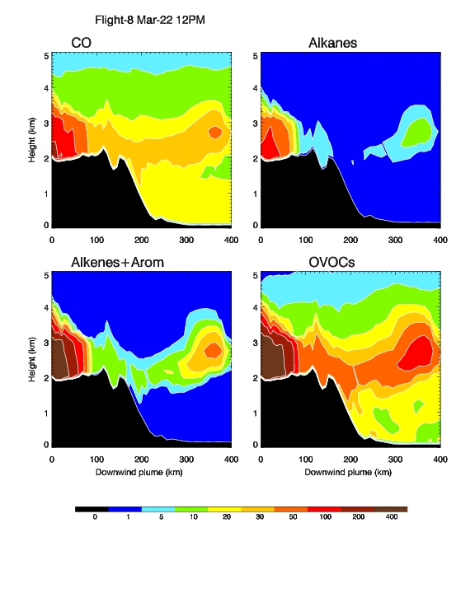
MIRAGE-MC studies (from Tie et al.)
Effect of Oxidized VOCs on ozone production (Eric Apple)

Slide 32
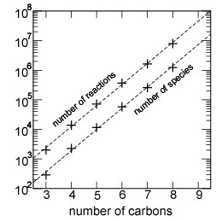
How complex a model is needed?

Slide 33
Evolution of Composition - Day 1
Julia Lee-Taylor, ACD

Slide 34
Evolution of Composition – Day 6
Note that distribution has shifted from gas to aerosol; complexity of mix!

