Slide 1

Nitrogen Compounds in the Atmosphere
Atmospheric Chemistry Division
Lecture Series
2011

Slide 2
Nitrogen “Families”
N₂
N₂O
NO_{x} (NO + NO₂)
N₂O₅
HNO₃ (HONO₂)
HONO
HOONO₂
PANs (RC(O)OONO₂)
Alkyl Nitrates (RONO₂)
XONO2 (X = halogen)
NO₃ radical
NO₃⁻ nitrate aerosol
“NOy”

Slide 3
N₂
Nitro – gen (found in HNO3 in the 18th century)
Azotos – “lifeless gas”
Stickstoff – “asphyxiating substance”
Extremely stable, bond energy 945 kJ/mol

Slide 4
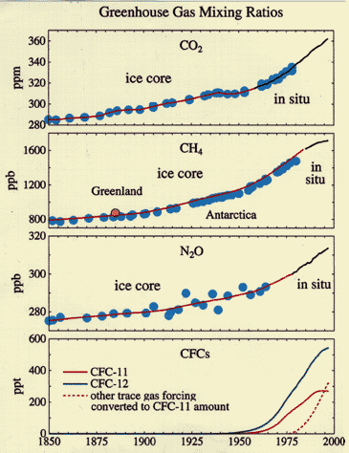
N₂O
Greenhouse gas
40/60 anthro/bio sources
Increase of ~20% due to
anthropogenic emissions
120 year atmospheric lifetime
stratospheric NO_{x} source
Ledley et al, 1999

Slide 5
Stratospheric NO_{x} Chemistry
N₂O + O(¹D) → 2 NO (~60%)
→ N₂ + O₂ (~40%)
O₃ + hv → O₂ + O(¹D)
N₂O + hv → N₂ + O(¹D)
Catalytic Ozone destruction “null cycle”
Cycle (Stratosphere): Stratosphere + Troposphere:
NO + O₃ → NO₂ + O₂ NO + O₃ → NO₂ + O₂
NO₂ + O → NO + O₂ NO₂ + hv → NO + O
O + O₃ → 2 O₂ O₃ → O + O₂

Slide 6
Stratospheric NO_{x} Chemistry
Catalytic Ozone destruction cycles (Stratosphere):
NO + O₃ → NO₂ + O₂ Cl + O₃ → ClO + O₂
NO₂ + O → NO + O₂ ClO + O → Cl + O₂
O + O₃ → 2 O₂ O + O₃ → 2 O₂
But…
ClO + NO₂ → ClONO₂

Slide 7
Ozone “hole” chemistry
Lower Stratosphere “denitrified” and chlorine activated
ClONO₂ + HCl(s) → Cl₂ + HNO₃(s)
ClONO₂ + H₂O(s) → HOCl + HNO₃(s)
N₂O₅ + HCl(s) → ClNO₂ + HNO₃(s)
N₂O₅ + H₂O(s) → 2 HNO₃(s)
Cl + O₃ → ClO + O₂
ClO + O → Cl + O₂
O + O₃ → 2 O₂

Slide 9
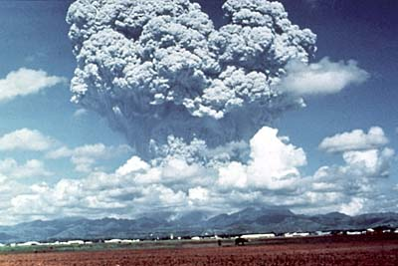
Ozone “hole” chemistry
Lower Stratosphere “denitrified” and chlorine activated
ClONO₂ + HCl(s) → Cl₂ + HNO₃(s)
ClONO₂ + H₂O(s) → HOCl + HNO₃(s)
N₂O₅ + HCl(s) → ClNO₂ + HNO₃(s)
N₂O₅ + H₂O(s) → 2 HNO₃(s)
Cl + O₃ → ClO + O₂
ClO + O → Cl + O₂ Pinatubo eruption, 1991, Photo: USGS
O + O₃ → 2 O₂

Slide 10
Tropospheric Reactive Nitrogen

Slide 11
Tropospheric Reactive Nitrogen
NO_{x} (NO + NO₂)
N₂O₅
HNO₃ (HONO₂)
HONO
HOONO₂
PANs (RC(O)OONO₂)
Alkyl Nitrates (RONO₂)
XONO2 (X = halogen)
NO₃ radical
NO₃⁻ nitrate aerosol
NH₃, Amines
NO_{y}, or
odd nitrogen
NO_{z} = NO_{y}-NO_{x}
NO_{y} reservoir
species

Slide 12
Tropospheric Reactive Nitrogen
NO_{x} (NO + NO₂)
N₂O₅
HNO₃ (HONO₂)
HONO
HOONO₂
PANs (RC(O)OONO₂)
Alkyl Nitrates (RONO₂)
XONO2 (X = halogen)
NO₃ radical
NO₃⁻ nitrate aerosol
NH₃, Amines
NO_{y}, or
odd nitrogen
NO_{z} = NO_{y}-NO_{x}
NO_{y} reservoir
species
Sources of reactive Nitrogen

Slide 13
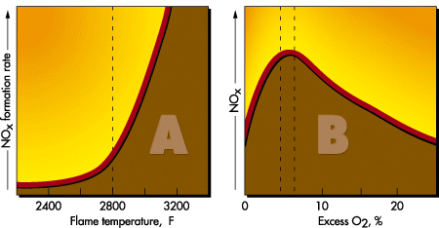
Combustion source for NOx
No nitrogen in fuel
N₂ + O = NO + N +314 kJ/mol
N + O2 = NO + O
N + OH = NO + H (not important)
Nitrogen in Fuel
HCN_{(g)}, RCN_{(g)}, NH₃, etc + OH/O →→ NOx
Alentec Inc.

Slide 14
NO_{x} emission sources
NO_{x} + VOC + O₃
NO_{x} + VOCs
cities (transportation)

Slide 15
NO_{x} emission sources
NO_{x} + VOC + O₃
NO_{x} + VOCs
VOCs
NO_{x}
NO_{x} + VOCs
NO_{x} + VOCs
Cities (transportation)
Forests
power plants
Industry
Soils and
Agriculture

Slide 16
NO_{x} emission sources
Lightning
NO_{x} + VOC + O₃
NO_{x} + VOC
NO_{x}
NO_{x} + VOC
NO_{x} +VOC
VOC
NO_{x} + VOC
cities (transportation)
forests
power plants
industry
fires
Soils and
Agriculture

Slide 17
Sources of U.S. NO_{x} and VOC Emissions
NO_{x}
VOCs
Other
Natural
Non-Road
Other
10%
6%
Engines
7%
5%
Electric
On-Road
Non-Road
Utility
Vehicles
Engines
24%
11%
18%
Solvent Use
Natural
13%
61%
Industrial
Industrial
13%
3%
On-Road
Vehicles
29%
Source: EPA

Slide 18

Global Budget of NO_{x} in the Troposphere (Tg N/yr) 80s-90s
Ehhalt and Drummond Logan Sanhueza (1982) (1983) (1991)
Sources/Production
Fossil fuel combustion 13.5 (8.2-18.5) 21.0 (14-28) 21
Biomass burning 11.5 (5.6-16.4) 12.0 (4-24) 2.5-8.5
Soil emission 5.5 (1-10) 8.0 (4-16) 10-20 Lightning 5.0 (2-8) 8 (2-20) 2-8
NH3 oxidation 3.1 (1.2-4.9) ? (0-10) -
Ocean emission - 1 -
Aircraft 0.3 (0.2-0.4) - 0.6
Stratospheric input 0.6 (0.3-0.9) 0.5 1
Total 39 (19-59) 50.5 (25-99) 37-59
Sinks
Wet deposition 24 (15-33) 27 (12-42) -
Dry deposition - 16 (11-22) -
Total 24 (15-33) 43 (23-64) -

Slide 20
Modeled NO_{x} near surface (1990s)

Slide 21
IPCC AR4 NOx in the troposphere (2000)

Slide 22
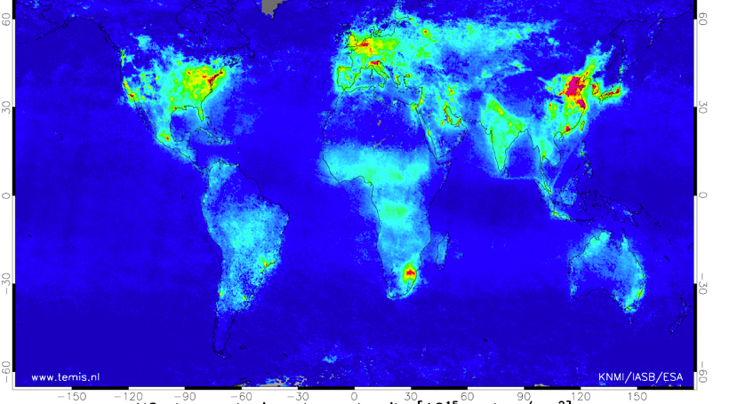
SCIAMACHY global mean NO2 (2004)

Slide 23
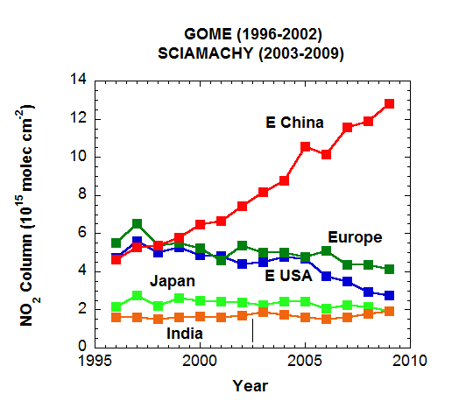
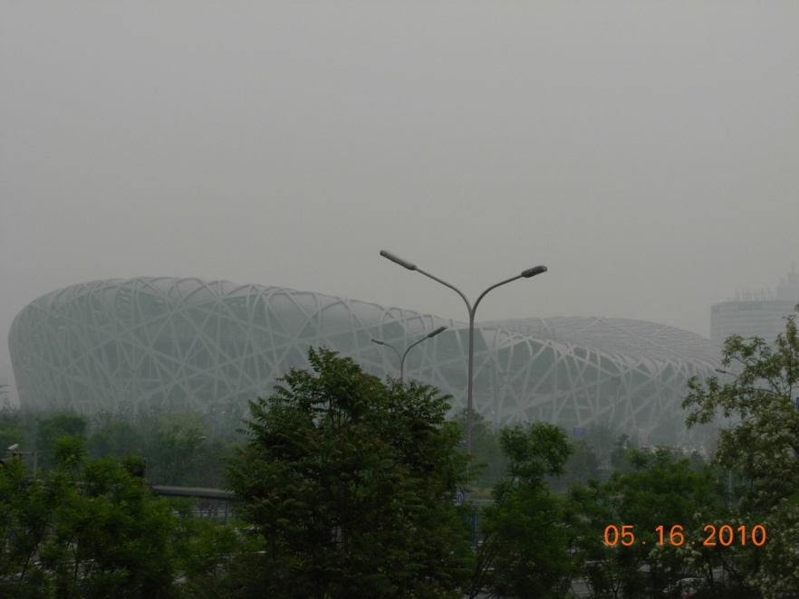
Developments in Asia
(Steve Massie)
1000 cars / day are added
to the Beijing road system
China GDP and NO₂ trends ~ 10 % / year

Slide 24

NO_{x} emissions
… a moving target

Slide 25
NO_{x} emissions
http://www.iiasa.ac.at/web-apps/tnt/RcpDb/dsd?Action=htmlpage&page=compare

Slide 26
NOx chemistry in the troposphere
NO_{x} is synonymous with
“photochemical smog”
or ozone photochemistry

Slide 27
NOx chemistry in the troposphere

Slide 28
NOx chemistry in the troposphere

Slide 29
NOx chemistry in the troposphere

Slide 30
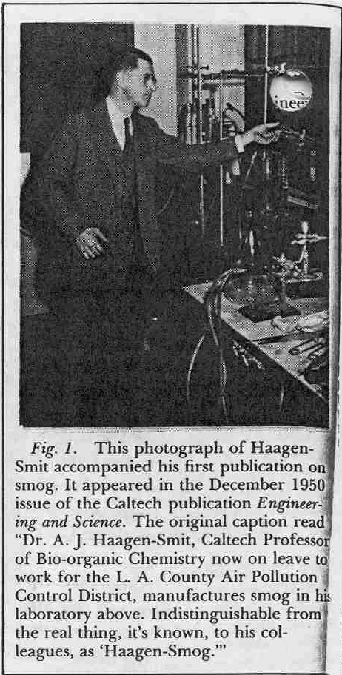
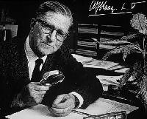
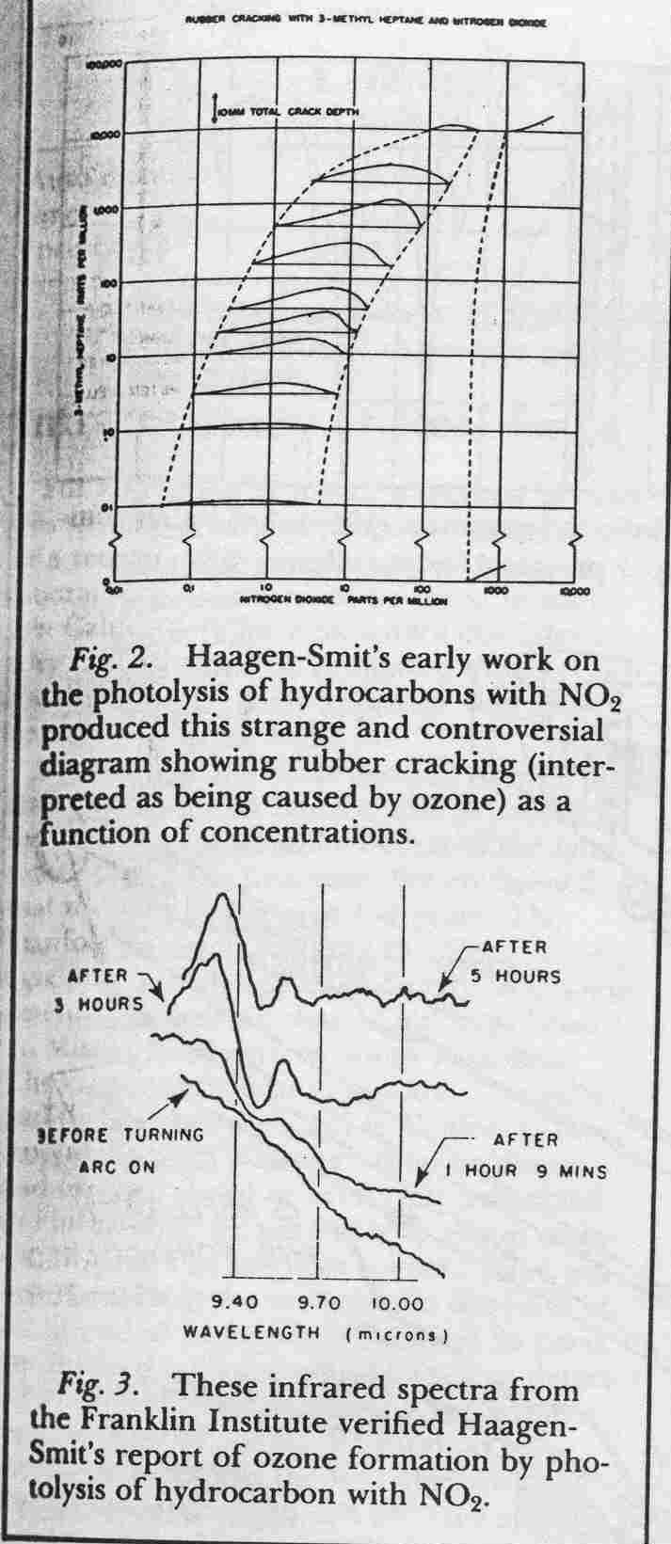
Photochemical Smog – 1950’s
Arie-Jan Haagen-Smit: “Ozone from smog and sunlight”

Slide 31
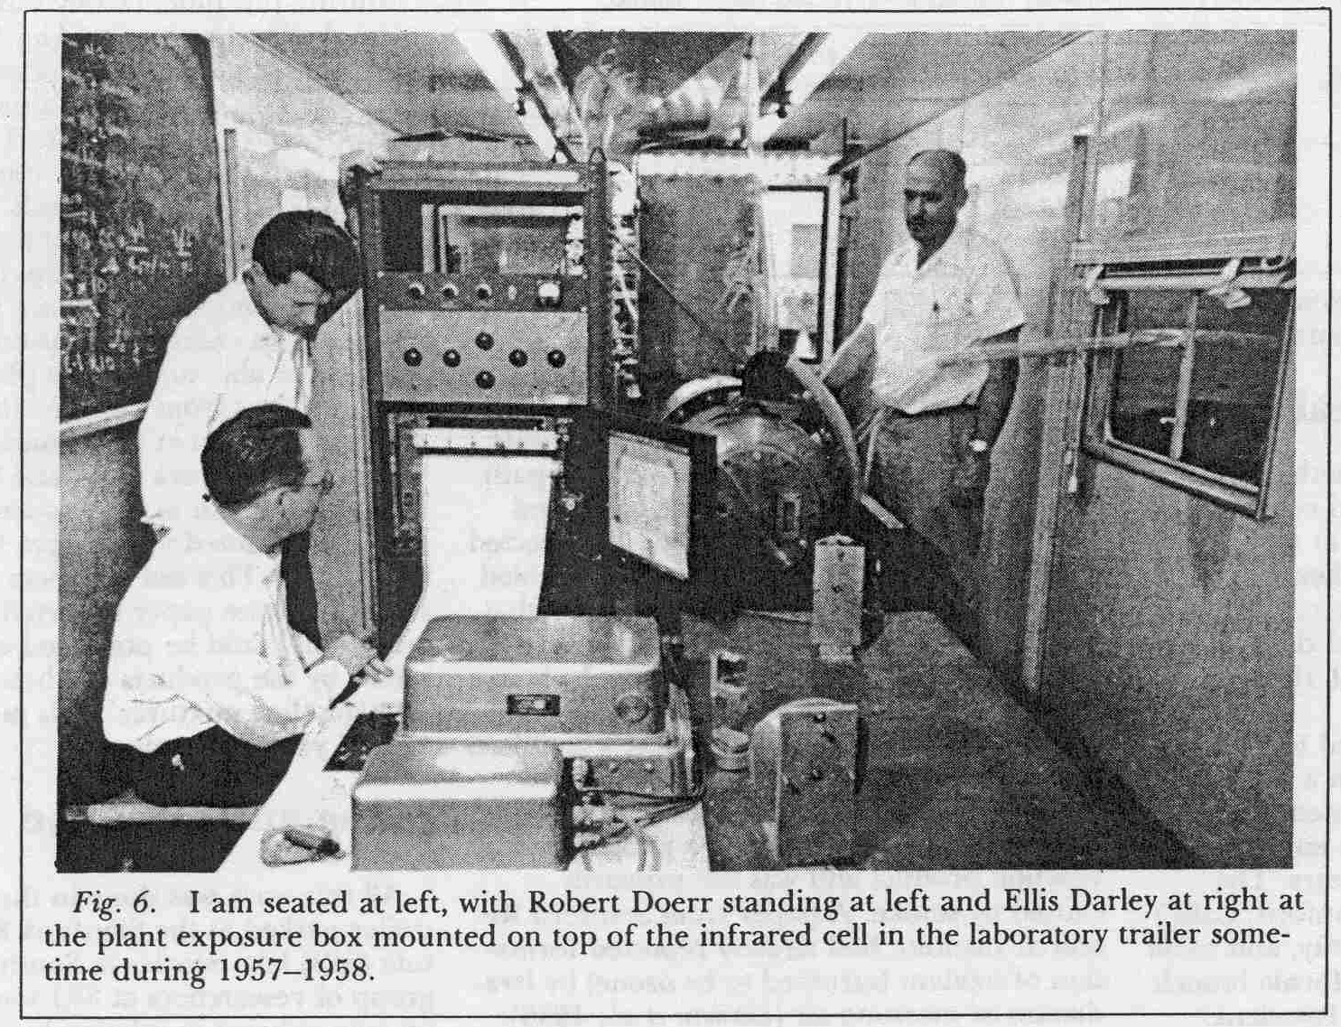
Photochemical Smog – 1950’s
Edgar Stephens, et al, 1956: Discovery of PAN (“compound X”)

Slide 32
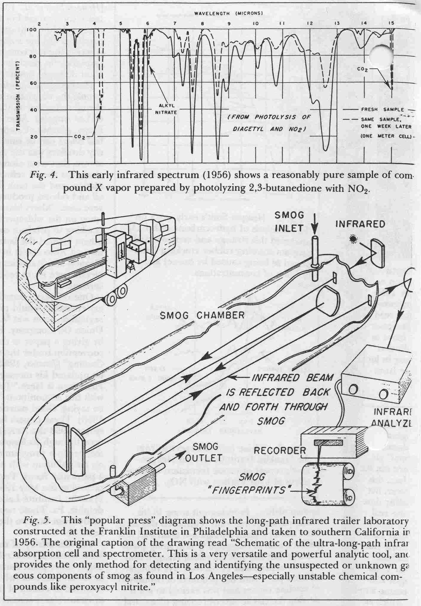
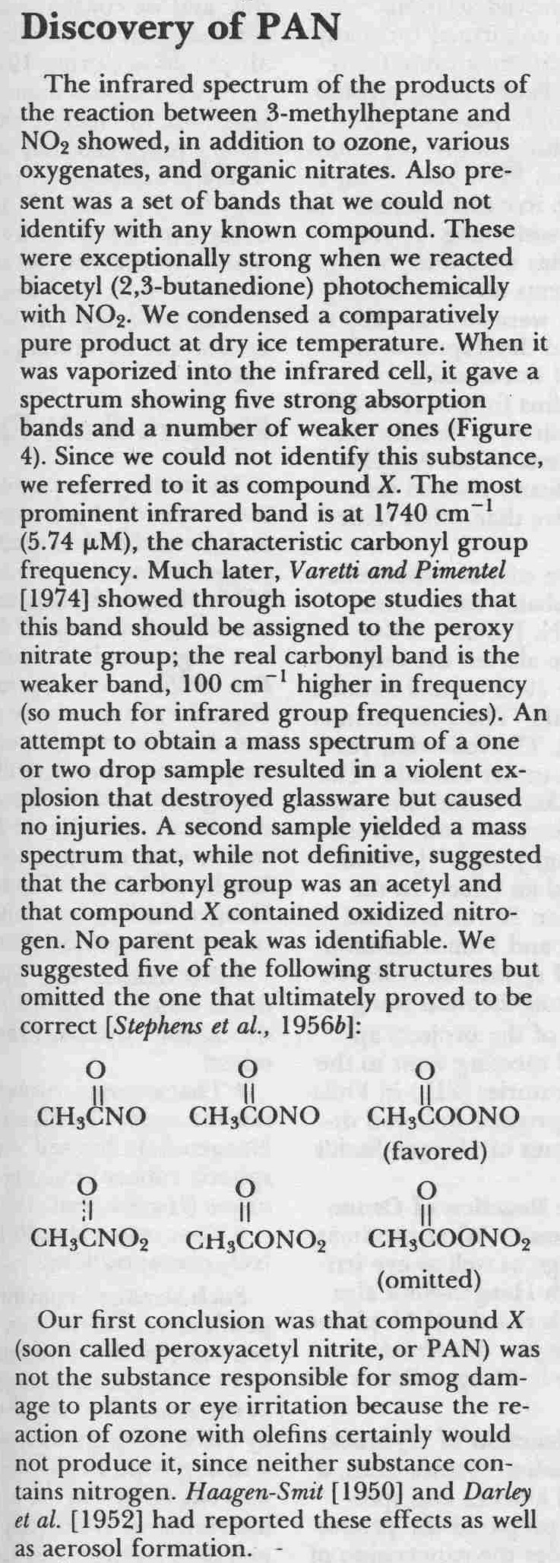
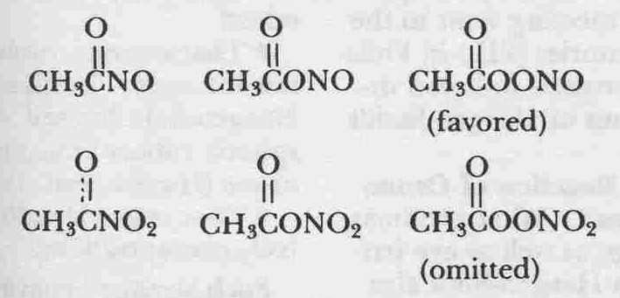
Photochemical Smog – 1950’s
Edgar Stephens, et al, 1956: Discovery of PAN (the first NOx reservoir species)

Slide 33
Photochemical processes involving NO_{x}
Leighton, 1961:
“O₃ and NO_{x} live in photostationary state”

Slide 34
NO_{x} photostationary state
O₃ + NO → NO₂ + O₂
NO₂ + hv → NO + O
O + O₂ + M → O₃ + M
______________________
Null
t ≈ 100 seconds
[NO]/[NO₂] = k[O₃] / J_{NO2}
P(O₃) = 0
O_{x} = O₃ + NO₂

Slide 35
Photochemical processes and tropospheric ozone formation
Leighton, 1961: O₃ and NO_{x} (NO+NO₂) live in a “photostationary state”
H. Levy, 1972: OH radical oxidizes CO, CH₄, VOC
P. Crutzen et al., W. Chameides et al., J. Logan et al. late 70’s: HO_{x} and NO_{x} cycles responsible for ozone production in the troposphere

Slide 36
Role of NO_{x} in ozone production
OH + CO → CO₂ + H
H + O₂ +M → HO₂ + M
HO₂ + NO → NO₂ + OH
NO₂ + hv → NO + O
O + O₂ + M → O₃ + M
______________________
CO + 2 O₂ +hv → CO₂ + O₃
OH + CH₄ +O₂ → CH₃O₂ + H₂O
CH₃O₂ + NO → NO₂ + CH₃O
CH₃O + O₂ → HO₂ + CH₂O

Slide 37
Role of NO_{x} in ozone production
HO₂ + NO → NO₂ + OH
CH₃O₂ + NO → NO₂ + CH₃O
CH₃O + O₂ → HO₂ + CH₂O
NO₂ + hv → NO + O
O + O₂ + M → O₃ + M
O₃ + NO → NO₂ + O₂
P(O₃) = [NO] * (k’[HO₂] + k”[CH₃O₂])
[NO]/[NO₂] = (k[O₃] + k’[HO₂] + k”[CH₃O₂]) / J_{NO2}
k’
k”
k

Slide 41
Near-Zero NO_{x} troposphere
OH + CO → CO₂ + H
H + O₂ +M → HO₂ + M
HO₂ + O₃ → 2 O₂ + OH
HO + O₃ → O₂ + HO₂
___________________
CO + O₃ → CO₂ + O₂
O₃ + hv → O(¹D) + O₂
O(¹D) + M → O + M
O(¹D) + H₂O → 2 OH
k_{l}”
k_{l}’
J_{O1D}
f

Slide 42
Ozone production and loss
P(O₃) = [NO] * (k’[HO₂] + k”[CH₃O₂])
L(O₃) = [O₃] * (k_{l}’[OH] + k_{l}”[HO₂] + f J_{O1D})
P(O₃) = L(O₃)
[O₃] * (k_{l}’[OH] + k_{l}”[HO₂] + f J_{O1D})
NO’ =
k’[HO₂] + k”[CH₃O₂]

Slide 43
Mauna Loa Hawaii

Slide 44
Mauna Loa Hawaii

Slide 45
Mauna Loa Hawaii

Slide 46
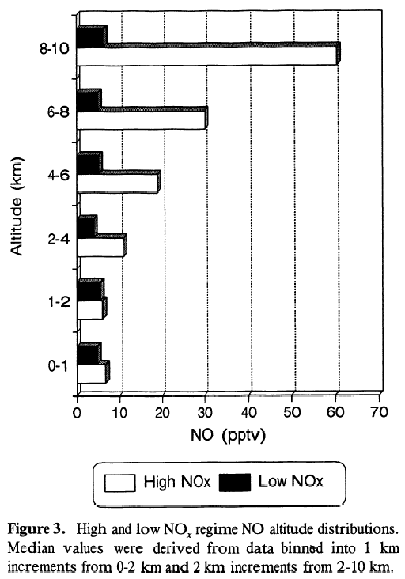
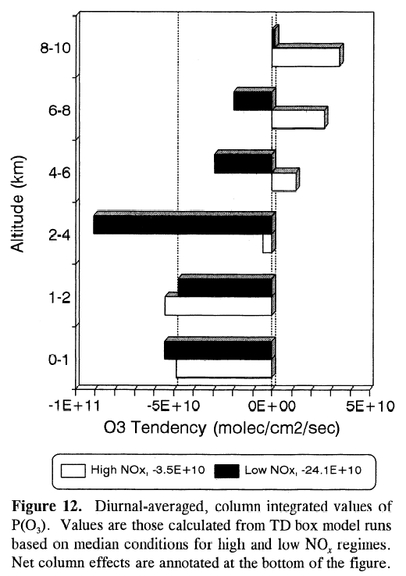
Ozone budget: Box model simulations
Profiles of NO and net O₃ production rates during PEM-WEST B, 1994
Separation into two distinct air mass types (high NO_{x} and low NO_{x})
[Crawford et al., JGR 102, 1997]
NO profiles
Net P(O₃) profiles

Slide 47
Near-Zero NO_{x} troposphere
OH + CO → CO₂ + H
H + O₂ +M → HO₂ + M
HO₂ + O₃ → 2 O₂ + OH
HO + O₃ → O₂ + HO₂
___________________
CO + O₃ → CO₂ + O₂
HO₂ + HO₂ → H₂O₂
HO₂ + HO → H₂O + O₂
H₂O₂+hv → 2 OH
H₂O₂ + H₂O_{(liq)} → H₂O_{2(liq)}

Slide 48
Back to the role of NO_{x} in the chemistry of the troposphere

Slide 49
Does NO_{x} cycle around forever?
HO₂ + NO → NO₂ + OH
CH₃O₂ + NO → NO₂ + CH₃O
CH₃O + O₂ → HO₂ + CH₂O
NO₂ + hv → NO + O
O + O₂ + M → O₃ + M
O₃ + NO → NO₂ + O₂
P(O₃) = [NO] * (k’[HO₂] + k”[CH₃O₂])
[NO]/[NO₂] = (k[O₃] + k’[HO₂] + k”[CH₃O₂]) / J_{NO2}
k’
k”
k

Slide 50
NO_{x} loss reactions (remote trop)
NO₂ + OH + M → HNO₃ + M k_{n}
NO_{x} lifetime:
τ(NO_{x}) = τ(NO₂) (1+[NO]/[NO₂])
Catalytic efficiency:
CE ≈ P(O₃) / L(NO_{x})
CO cycle only:
CE ≈ k’[NO][HO₂] / k_{n}[OH][NO₂]

Slide 51
NO_{x} influence on HO_{x} partitioning

Slide 52
Problems
Calculate the “critical NO” (P(O3) = L(O3)) for the following conditions:
Surface, t=298K, [HO₂] = 40 ppt, [CH3O2] = 25 ppt, [O3] = 40 ppb, [OH] = 1x10⁶; f = 0.15; J(O¹D) = 2.5x10⁻⁵
k’=k”= 8.5x10⁻¹² cm³ molecule⁻¹ s⁻¹
k_{l}’= 7.3x10⁻¹⁴ cm³ molecule⁻¹ s⁻¹; k_{l}”= 2x10⁻¹⁵ cm³ molecule⁻¹ s⁻¹
Which of these reactions are the most important?
Calculate the lifetime of NO_{x} at the surface and at 10km altitude, considering only losses to HNO₃
[OH] = 1x 10⁶, J(NO₂)=1x10⁻²; consider alt-independent
[O₃] = 40 ppb / 100 ppb; T=298K / 220K at surf/10km, resp.
k = 1.4 x 10⁻¹² exp(-1310/T) cm³ molecule⁻¹ s⁻¹
k_{n} = 3.3 x 10⁻³⁰ (T/300)^{-3.0} [N₂] cm³ molecule⁻¹ s⁻¹
What are the [NO]/NO₂] ratios at 0 and 10 km?

Slide 53
Beyond the remote troposphere
Addition of a reactive hydrocarbon (isoprene):
Enhances [HO_{x}]
Shifts O₃ production peak to larger NO_{x} values
Still eventually turns over at high NO_{x}

Slide 54
NO_{y}: nitrogen “reservoir” species
NO₂ + OH + M → HNO₃ + M
NO₂ + RO₂ + M ROONO₂ + M
NO₂ + RC(O)O₂ + M RC(O)OONO₂ + M
NO + RO₂ + M → RONO₂ + M (0-30%)
RONO₂ + hv → RO + NO₂
NO + OH + M → HONO + M
NO₂ + O₃ → NO₃ + O₂
NO₃ + NO₂ + M N₂O₅ + M
NO₂ + NO₂ + H2O_{liq} → HONO_{g} + HNO_{3liq}

Slide 55
NO_{x} catalytic efficiency
CE ≈ P(O₃) / L(NO_{x})
[NO]{k’[HO₂] + Σ (k’_{i}[RO₂]_{i})}
CE ≈
k_{n}[OH][NO₂]+k_{m}[NO₂][RC(O)O₂] +..+..
….or determine it experimentally
CE ≈ P(O₃) / P(NO_{y}-NO_{x})

Slide 56
A day in NO_{x} city
O₃
100
75
50

Slide 57
Experimental determination of CE

Slide 58
NO_{y}: nitrogen “reservoir” species
NO₂ + OH + M → HNO₃ + M
NO₂ + RO₂ + M ROONO₂ + M
NO₂ + RC(O)O₂ + M RC(O)OONO₂ + M
NO + RO₂ + M → RONO₂ + M (0-30%)
RONO₂ + hv → RO + NO₂
NO + OH + M → HONO + M
NO₂ + O₃ → NO₃ + O₂
NO₃ + NO₂ + M N₂O₅ + M
NO₂ + NO₂ + H2O_{liq} → HONO_{g} + HNO_{3liq}

Slide 59
HONO and ClNO₂
NO + OH + M → HONO + M
NO₂ + NO₂ + H2O_{liq} → HONO_{g} + HNO3_{liq}
N2O5 + NaCl_{liq} → NaNO_{3(liq)} + ClNO₂
HONO + hv → OH + NO
ClNO₂ + hv → Cl + NO₂
Early morning sources of radicals

Slide 60
Organic Nitrates
Peroxy nitrates
NO₂ + RO₂ + M ROONO₂ + M
Alkyl nitrates
NO + RO₂ + M → RONO₂ + M (0-30%)
NO + RO₂ → NO₂ + RO (70-100%)
Peroxy Acyl Nitrates (PANs)
NO₂ + RC(O)O₂ + M → RC(O)OONO₂ + M

Slide 61
Alkyl nitrates
NO + RO₂ + M → RONO₂ + M (α)
NO + RO₂ → NO₂ + RO (1-α)
P(O₃) = (1-α) k [NO][RO₂]
α ≈ 0.05-0.08
RONO₂ + hv → RO + NO₂
RONO₂→ dry deposition
−
−
−

Slide 62
Peroxyacyl nitrates (PANs)
NO₂ + RC(O)O₂ + M RC(O)OONO₂ + M
Equilibrium is strongly temperature dependent
NO + RC(O)O₂ → NO₂ + CO₂ + RO₂
In very cold environments / lower stratosphere:
RC(O)OONO₂ + hv → RC(O)O + NO₂
RC(O)OONO₂ + OH → products (NO₂)

Slide 63
PAN structure
O
PAN
CH₃ – C
O – O – NO₂
Peroxyacetyl nitrate
(Peroxyacetic nitric anhydride)
CH₃ – CH₃
Ethane

Slide 64
PAN formation
Strongly temperature dependent equilibrium
O
O
O
CH₃ – C • + O₂
CH₃ – C + NO₂
CH₃ – C
O – O •
O – O – NO₂
peroxyacetyl
radical
hv, OH

Slide 65
PAN formation
Strongly temperature dependent equilibrium
O
O
O
CH₃ – C • + O₂
CH₃ – C + NO₂
CH₃ – C
O – O •
O – O – NO₂
CH₃C(O)H + OH or + hv
(CH₃)₂C=O + hv
hv, OH

Slide 66
PAN formation
Strongly temperature dependent equilibrium
O
O
O
CH₃ – C • + O₂
CH₃ – C + NO₂
CH₃ – C
O – O •
O – O – NO₂
CH₃C(O)H + OH or + hv
(CH₃)₂C=O + hv
hv, OH
Many VOC + OH

Slide 67
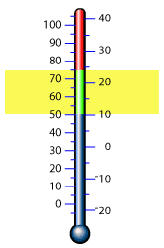
Atmospheric Lifetime of PAN
°F
°C
Thermal Photolysis OH
40 minutes 2 months 2 years
4 hrs.
1 day
1 week
1 month
1 year 3 months 4 years

Slide 68

a PAN’s life
HNO₃, PANs
PANs
(cold)
NO₂
O₃
VOC
NOx
NO
O₃
CO, CH4, long lived VOC
NO_{x}
NOx
(warm)

Slide 69
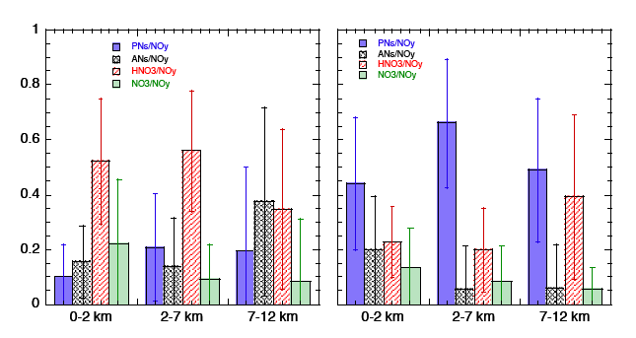
NOy partitioning polluted vs. remote
Singh et al., NASA

Slide 70
Arctic NOy

Slide 71
ATL, Cumb.,Johnsv.,PP, SOS99
Atlanta: High anthropogenic and biogenic NMHC Power plants: Mainly biogenic NMHC from surrounding forest Johnsonville power plant: NO_{x} emission controlled Cumberland power plant: very high NO_{x} emission (no control)

Slide 72
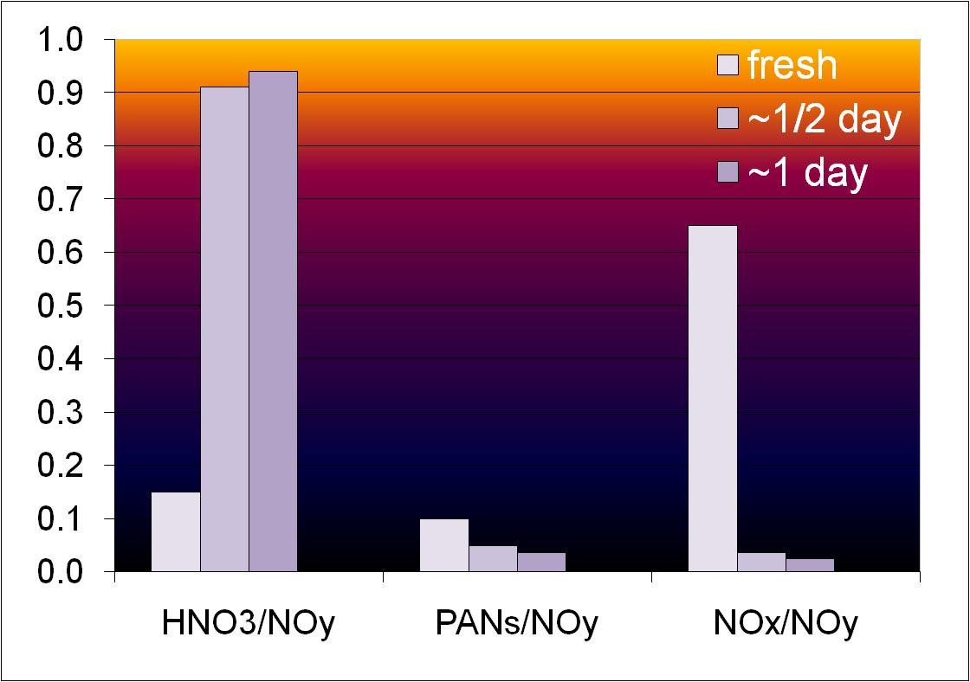
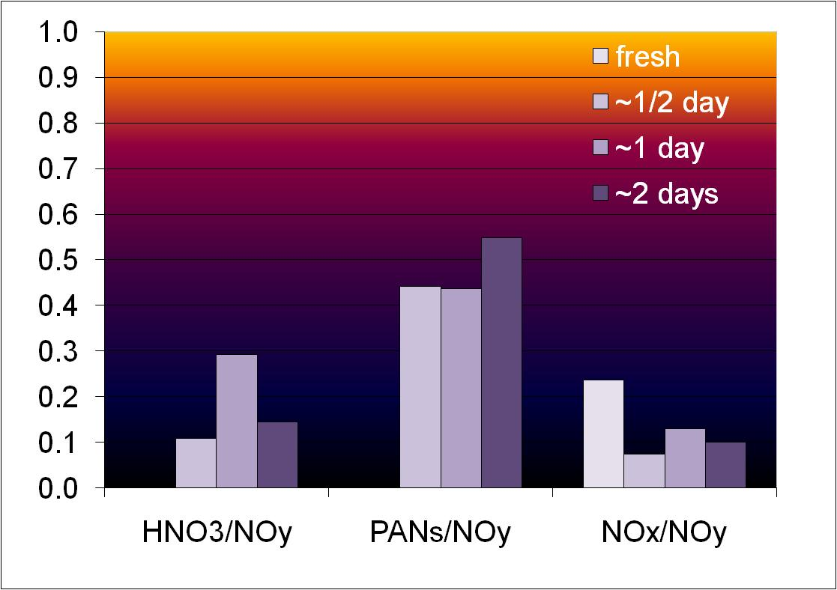
New York City vs. Mexico City
New York City Outflow
NYC – low level outflow, lower VOC:
Rapid conversion of NOx into HNO₃. Very little NOx remains one day downwind to produce additional ozone.
MC –high VOC , and outflow at higher altitudes:
Reactive nitrogen is carried out in its organic forms (PANs), which release NOx on a regional scale. This results in additional ozone production further downwind.
The high NOx and very high hydrocarbon emissions typical for a megacity like MC combine non-linearly to extend its impacts to a much larger region.
Mexico City Outflow
Notes:
Reactive Nitrogen – for NYC, high HNO3 low organic nitrogen (PANs), low NOx already after ½ day
for MC, low HNO3, HIGH PANs, and fairly high NOx even 2 days downwind.

Slide 73
CO emissions (PANs ?)

Slide 74
Ratios of different PANs species as indicators of the relative importance of certain hydrocarbon species (and emitters) for the photochemical production of ozone biogenic or anthropogenic ?

Slide 75

PPN structure
O
PPN
CH₃ – CH₂ – C
O – O – NO₂
Peroxypropionyl nitrate
(Peroxypropionic nitric anhydride)
CH₃ – CH₂ – CH₃
Propane

Slide 76
Formation of PANs from NMHC – Summary1
Ethane + OH + NO_{x} → O₃ PAN PPN PiBN MPAN
Propane + OH + NO_{x} → O₃ PAN PPN PiBN MPAN
Alkanes>C₃ + OH + NO_{x} → O₃ PAN PPN PiBN MPAN
What does PAN/PPN look like for anthropogenically polluted air?

Slide 77
PAN/PPN Houston all data
TexAQS 2000 campaign, urban and industrial pollution
PAN vs. PPN
Slope ~ 6

Slide 78
PAN/PPN TRACE
TRACE-P 2001 campaign - Asian urban and industr. pollution
PAN vs. PPN
Slope ~ 6

Slide 79
MPAN structure
O
H₂C
MPAN
C – C
CH₃
O – O – NO₂
Peroxymethacryloyl nitrate
(Methacryl-PAN)
H₂C
CH₂
C – CH
CH₃ Isoprene

Slide 80
Formation of PANs from NMHC – Summary alk/iso1
Ethane + OH + NOx → O₃ PAN PPN PiBN MPAN
Alkanes>C₂ + OH + NOx → O₃ PAN PPN PiBN MPAN
Alkanes>C₃ + OH + NOx → O₃ PAN PPN PiBN MPAN
Isoprene + OH + NOx → O₃ PAN PPN PiBN MPAN

Slide 81
SOS 99, all flights PAN – PPN correlation

Slide 82
PAN / PPN / MPAN multiple regression PAN/PPN ~ 6, PAN/MPAN ~ 3

Slide 83
What about Ozone / PAN ?

Slide 84
Cumberland/Johnsonville PAN/O3

Slide 85
O3 production from Isoprene in power plant plumes:
The yield of PAN from isoprene oxidation is about 20% (we know this from laboratory experiments)
The slope of ozone vs. PAN is about 15 molecules of ozone formed per molecule of PAN formed in the plumes (measured)
Most of the ozone is formed following oxidation of isoprene (we know this by the absence of PPN and presence of MPAN in these plumes)
The number of ozone molecules formed per isoprene molecule oxidized can be calculated to about 15 · 0.2 = 3
Important result to test plume models, photochemical point models (test of understanding of chemistry by comparison with isoprene flux estimates – isoprene is VERY short-lived!)

Slide 86
Problem - Homework
The photolysis of acetone, (CH3)2CO and reaction of Acetaldehyde, CH3CHO with OH, are sources of PAN in the atmosphere. Consider only acetone photolysis
CH₃C(O)CH₃ + hv + O₂ → CH₃C(O)OO + CH₃
CH₃C(O)OO + NO → CH₃ + CO₂ + NO₂
CH₃C(O)OO + NO₂ → PAN
PAN → CH₃C(O)OO + NO₂
Show that:
Steady-state [PAN] is independent of [NO_{x}]
[PAN] increases with increasing O₃ and Acetone
*use reaction constants from ACD Textbook

Slide 87
So does NO_{x} just cycle between reservoir species and NO,NO₂ and hang around forever?

Slide 88
Tropospheric sinks of NO_{x}
NO₂ + OH + M → HNO₃ + M
HNO₃ + hv → OH + NO₂
HNO₃ + hv → OH + NO₂
HNO₃ + OH → H₂O + NO₃
NO₃ + NO → 2 NO₂
NO₃ + hv → NO + O₂ (8%)
HNO₃+H₂O_{(liq)} → HNO_{3 (liq)}
-2O_{x}
-HO_{x},-O_{x}
NO₂ + O₃ → NO₃ + O₂
NO₃ + NO₂ + M N₂O₅ + M
N₂O₅ + H₂O_{(liq)} → HNO_{3(liq)}
-3O_{x}

Slide 89
Tropospheric sinks of NO_{x}
Formation of nitrate aerosol*
Uptake of HNO₃ onto dust
Deposition of (multifunctional) RONO₂, RC(O)OONO₂ onto plants and soils
Deposition of (multifunctional) RONO₂ onto aerosols
* Reversible for NH₄NO₃

