Slide 1
Surface-Atmosphere Fluxes
Part II
Christine Wiedinmyer
christin@ucar.edu

Slide 2
Part II
What did we just learn?
  What is emitted?
  What are emission sources?
How is it applied?
  Why do we need to know emission rates?
  How do we apply measured emissions?
  How do we calculate emissions?
  EXAMPLE
    Fire Emissions

Slide 3
Emissions to the atmosphere
Volatile Organic Compounds (VOC)
Nitrogen Species
  NOx
  NH₃
Carbon monoxide
Sulfur species (SO₂)
Particles
  Chemistry
  Physical properties

Slide 4



Emission Sources
Natural (Biogenic/Geogenic)
  Lightning (NO_{x}) N₂→ NO_{x}
  Volcanoes (SO₂, aerosols)
  Oceans
  Vegetation
  * Highly variable in space and time, influenced by season, T, pH, nutrients…
Anthropogenic
  Mobile sources
  Industry
  Power generation
  Agriculture
FIRE

Slide 5
How much comes from these sources?

Slide 6

Global Emission Estimates:
Trace Gases
Yokelson et al., ACP, 2008
EDGARFT2000
Yan et al, GBC, 2005
Guenther et al., 1995; 2006; pers. comm.
GFEDv2
Andreae and Merlet, GBC, 2001

Slide 7
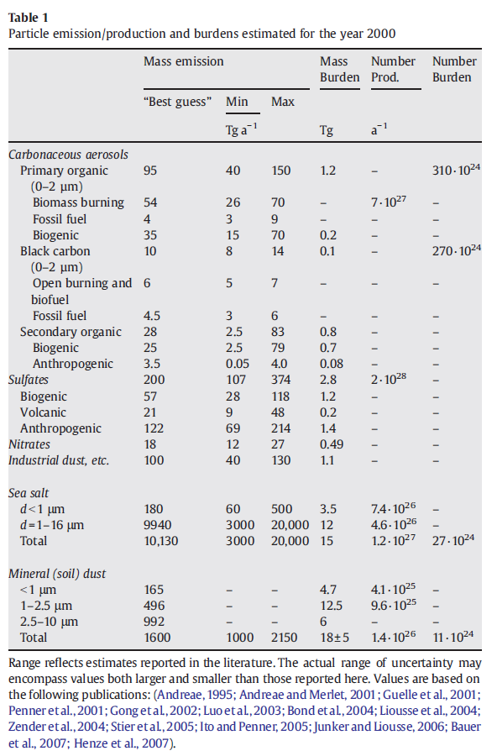
Global Emission Estimates:
Particles
Andreae and Rosenfeld, Earth Science Reviews, 2008

Slide 8
Andreae and Rosenfeld, Earth Science Reviews, 2008

Slide 9
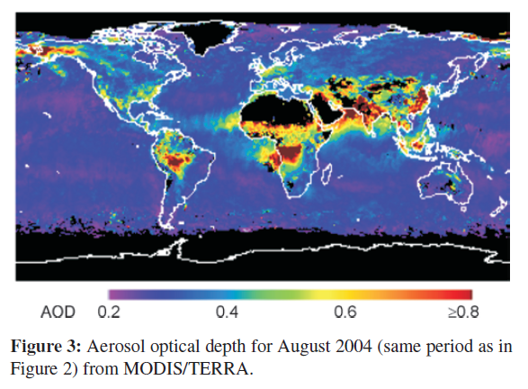
Location Matters!
Bronnimann et al., Meteorologische Zeitschrift, 2009

Slide 10
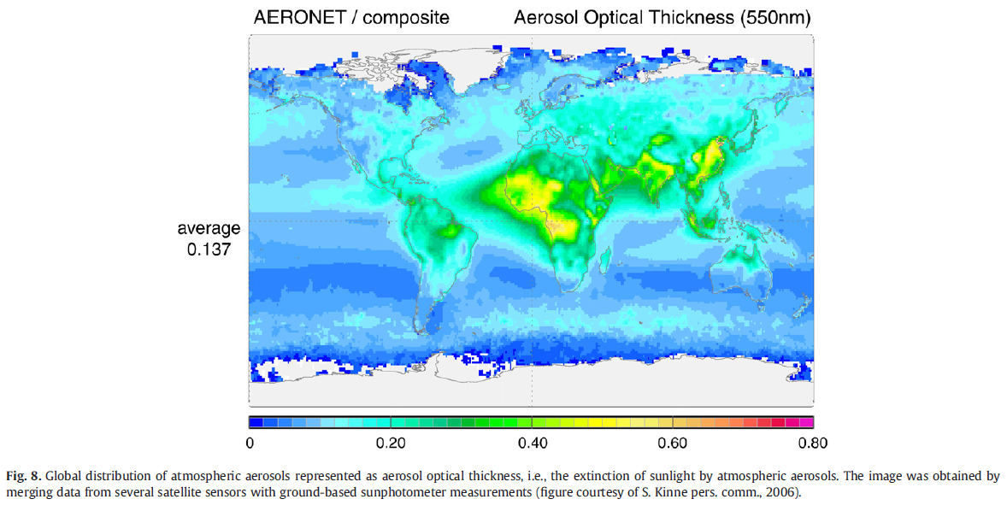
Andreae and Rosenfeld, Earth Science Reviews, 2008

Slide 11
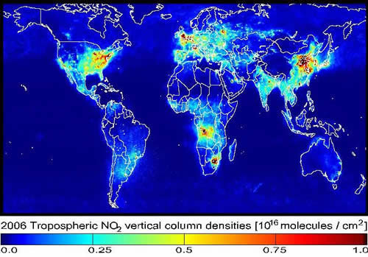
Satellite Data from OMI

Slide 12
Timing matters, too
Daily and seasonal trends in emissions have important implications on chemistry and air quality
For example: Why are you asked to fill up your gas tank in the evening during the summer smog season?

Slide 13
Tropospheric ozone forms in the presence of NOx, VOC and sunlight
Takes time to make (peaks in summer afternoon)
Emissions in morning contributes to daytime formation of ozone

Slide 14
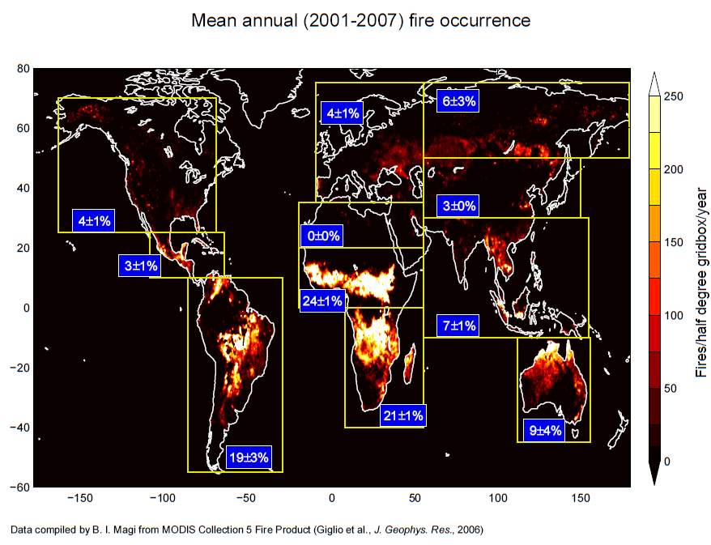
Example: Emissions from fires
Courtesy of Brian Magi, NOAA GFDL

Slide 15
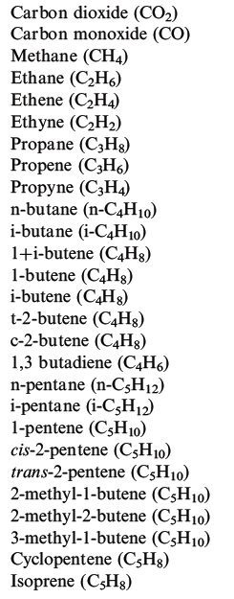
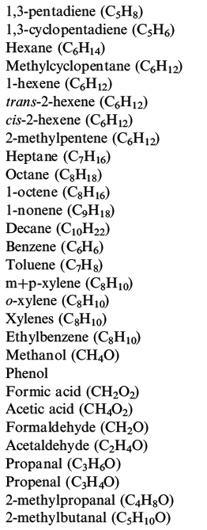
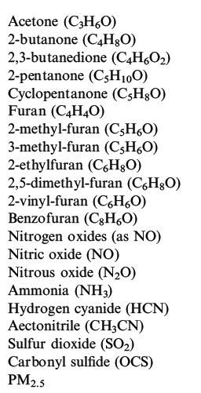
What is emitted from fires?
Urbanski et al., Wildland Fires and Air Pollution, 2009

Slide 16
What else do we need to consider?
Controlling variables:
- weather
- what burns
- how it burns
- where it burns
- when it burns

Slide 17
  A(x,t): Area burned
  B(x,t): Biomass burned (biomass burned/area)
    type of vegetation (ecology)
    fuel characteristics:
      amounts of woody biomass, leaf biomass, litter, ...
    fuel condition
      moisture content
  E_{fi}: Emission factor (mass emission_{i} /biomass burned)
    fuel characteristics
    fuel condition

Slide 18
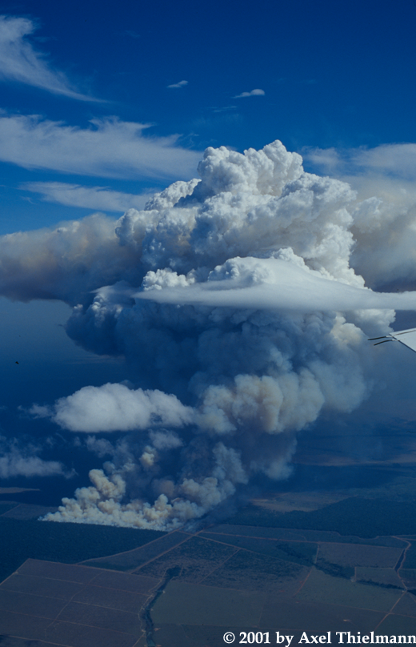
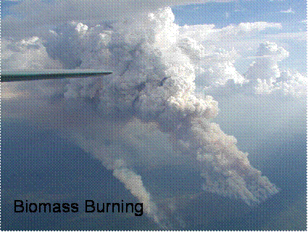
  (1) Emissions determined from field measurements
Thomas Karl, NCAR
TROFFEE Study, Brazil

Slide 19
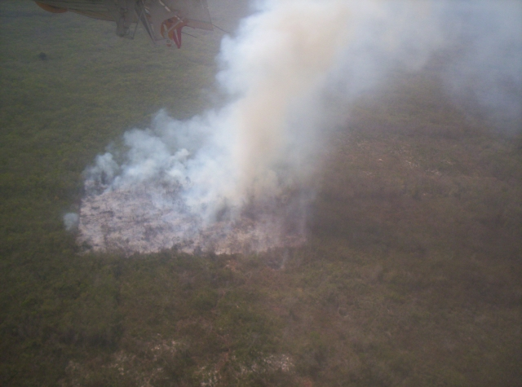
Deforestation Fire in the Yucatan, Mexico (March 2006)
Bob Yokelson, UMT
http://www.umt.edu/chemistry/faculty/yokelson.htm

Slide 20
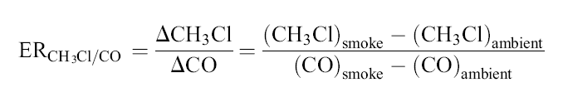
Emission Ratios
Example: CH₃Cl
Andreae and Merlet, Global Biogeochemical Cycles, 2001

Slide 21
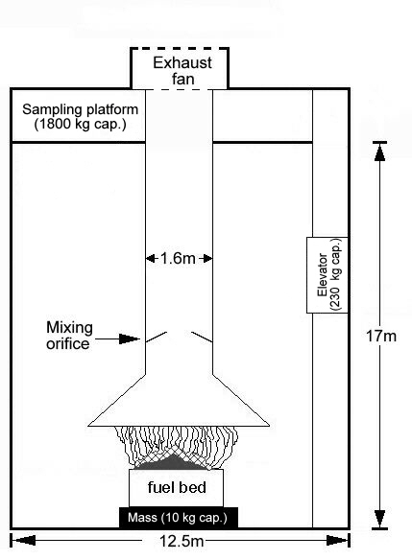
  (2) Fire emissions determined from laboratory experiments
A schematic of the USFS Fire Sciences Laboratory (FSL)
combustion facility in Missoula, MT.
http://www.umt.edu/chemistry/faculty/yokelson.htm

Slide 22
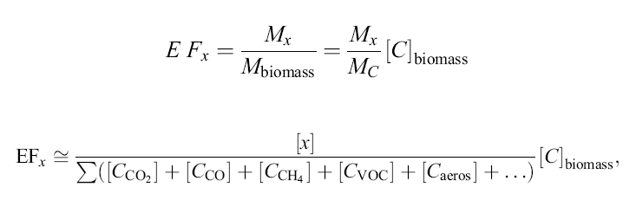
Getting at Emission Factors…
M_{x} Amount of compound released
M_{biomass} Amount of biomass burned
M_{c} Mass of carbon emitted
[C]_{biomass} Carbon concentration in biomass burned (45%)
[x] Concentration of species x in the smoke
[C_{i}] Concentration of species i in the smoke
Andreae and Merlet, Global Biogeochemical Cycles, 2001

Slide 23
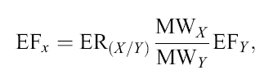
Measurements → Models
EF_{x} Emission factor for species X
ER_{(X/Y)} Emission ratio of species X relative to the reference species Y
MW_{x} Molecular weight of species X
MW_{Y} Molecular weight of species Y
EF_{Y} Emission factor of species Y
Andreae and Merlet, Global Biogeochemical Cycles, 2001

Slide 24
Measurements of Organic Compounds in Plumes
Canisters
  Analysis back at home (GC-FID, GC-MS, etc.)
FTIR
  E.g., Yokelson et al., University of Montana
PTR-MS
  E.g., Karl et al., NCAR

Slide 25
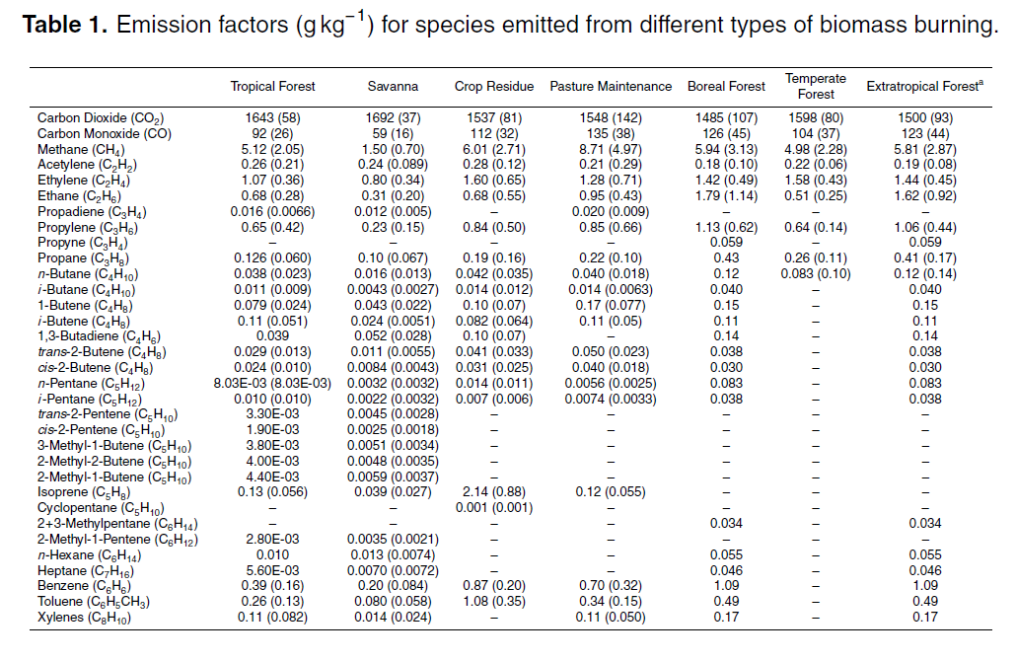
Akagi et al., Atmos. Phys. & Chem Disc., 2010

Slide 26
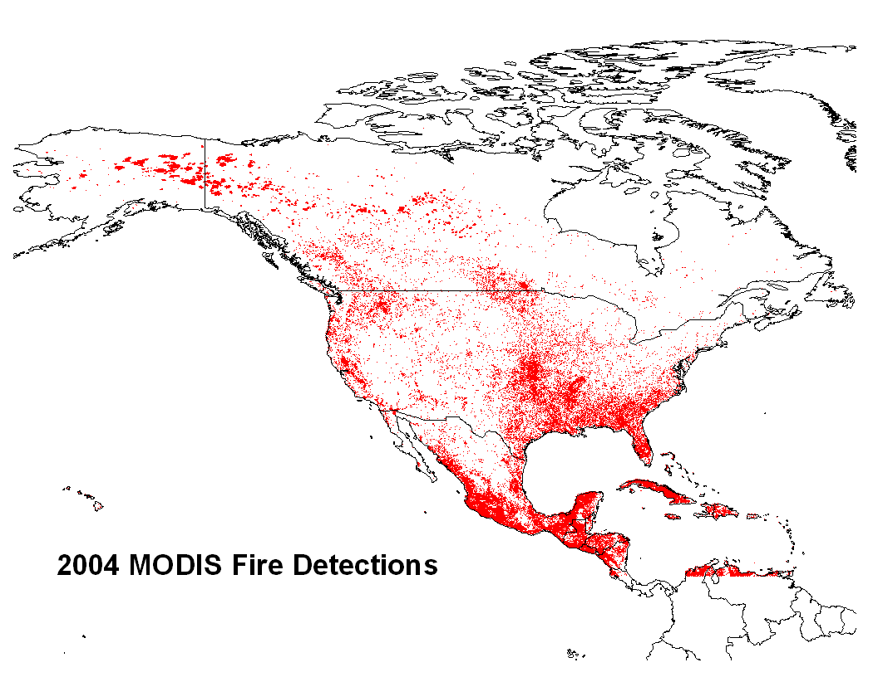
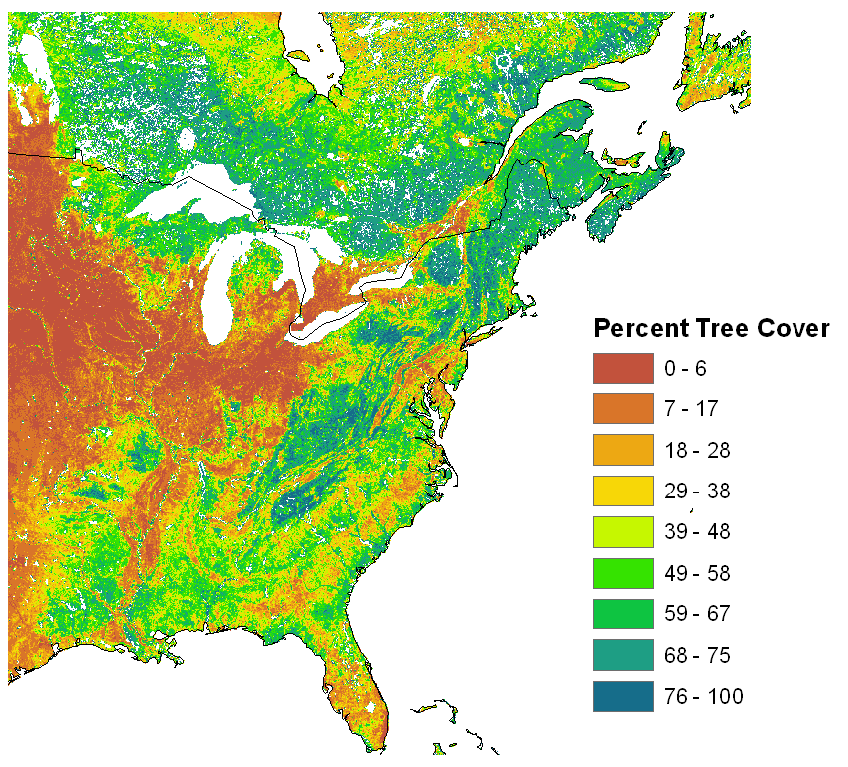
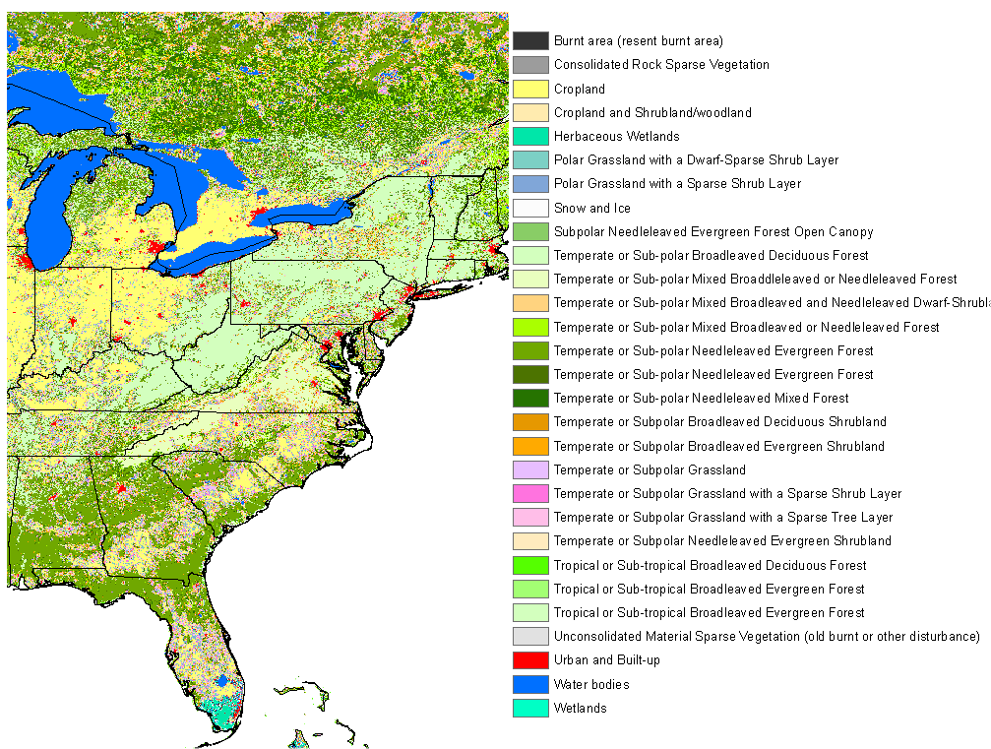
Other controlling variables
Vegetation burned
Location/timing
Fire severity

Slide 27
  A(x,t): Area burned
  B(x,t): Biomass burned (biomass burned/area)
    type of vegetation (ecology)
    fuel characteristics:
      amounts of woody biomass, leaf biomass, litter, ...
    fuel condition
      moisture content
  E_{fi}: Emission factor (mass emission_{i} /biomass burned)
    fuel characteristics
    fuel condition

Slide 28
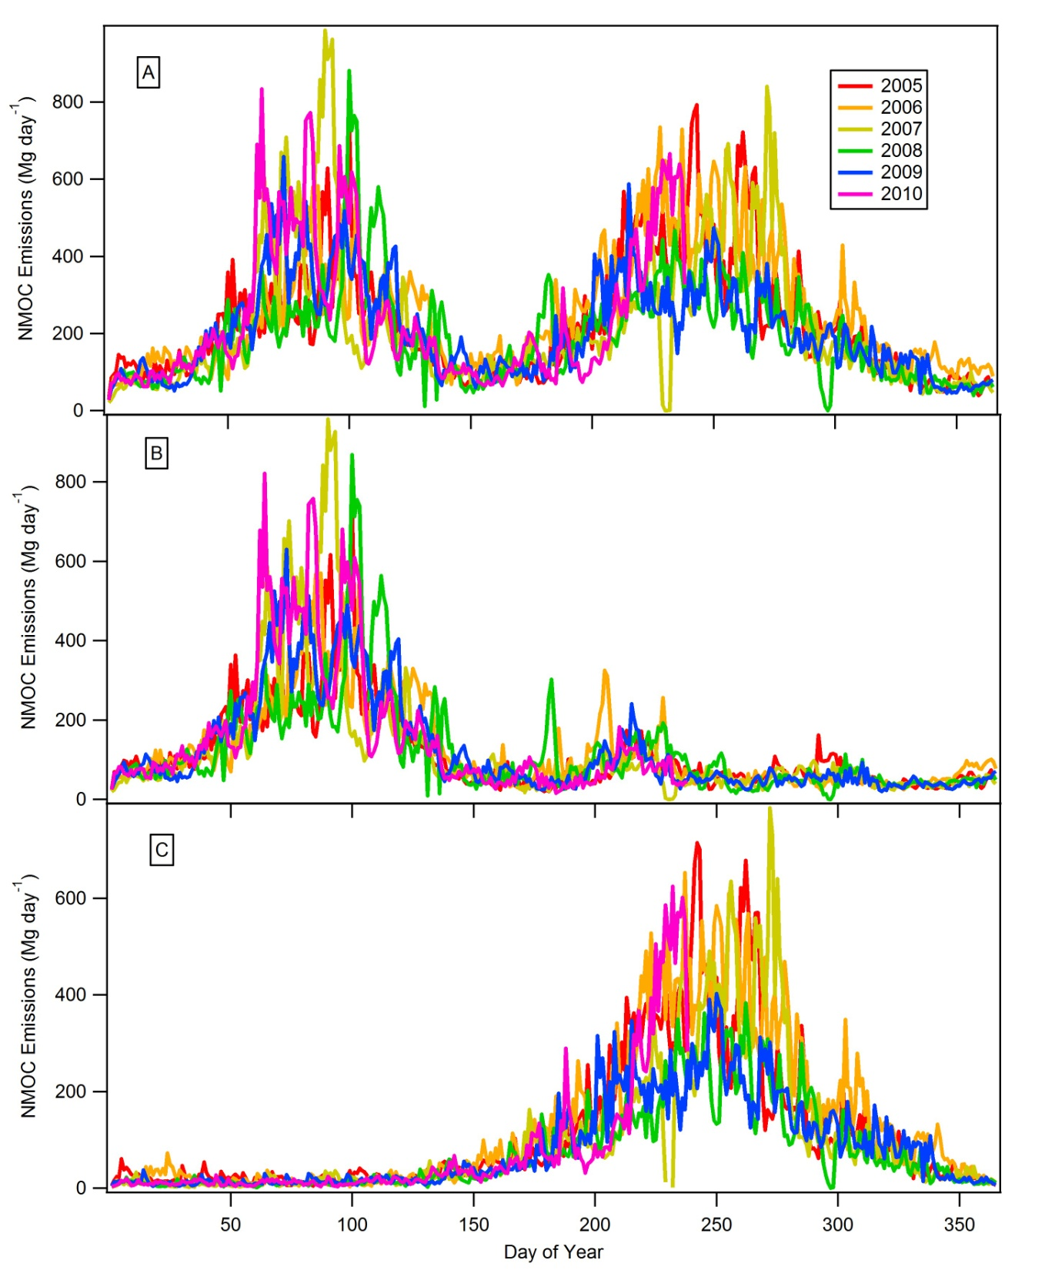
GLOBAL
Daily Emission estimates of non-methane organic compounds from fires
Northern Hemisphere
Southern Hemisphere
Wiedinmyer et al, Geosci. Model Dev. Discus., 2010

Slide 29
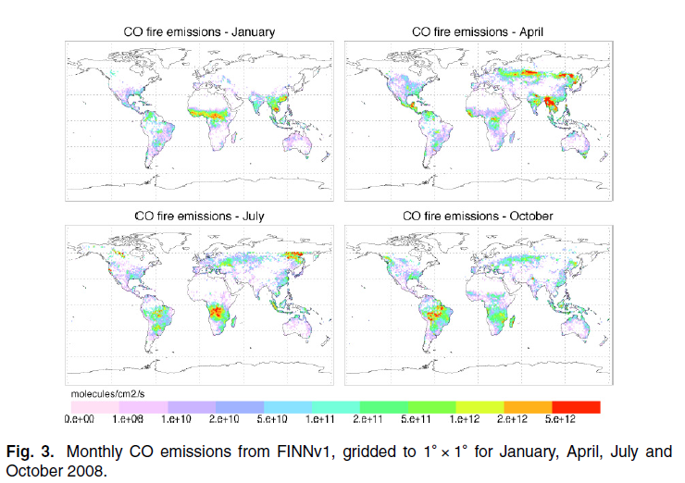
Wiedinmyer et al, Geosci. Model Dev. Discus., 2010

Slide 30
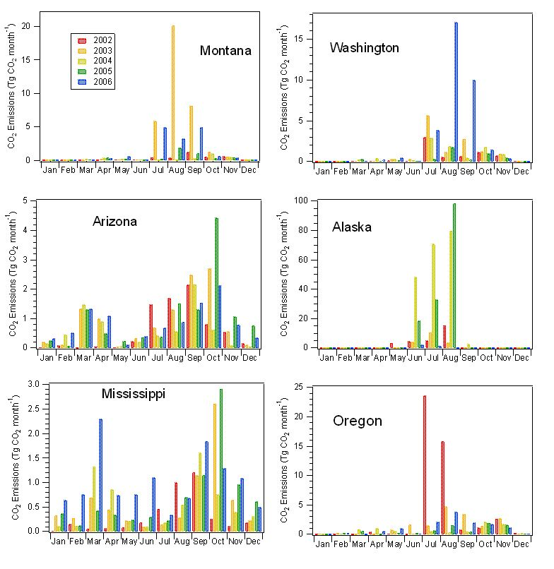
Fire Emissions
Variability:
Spatial
Temporal
Wiedinmyer and Neff, Carbon Balance and Management, 2007

Slide 31

Example: Mobile Source Emissions
What are ways that mobile sources emit gases and particles to the atmosphere?
  Tailpipe emissions
  Road dust
  Evaporative emissions
  Pumping gas

Slide 32
What needs to be considered?

Slide 33
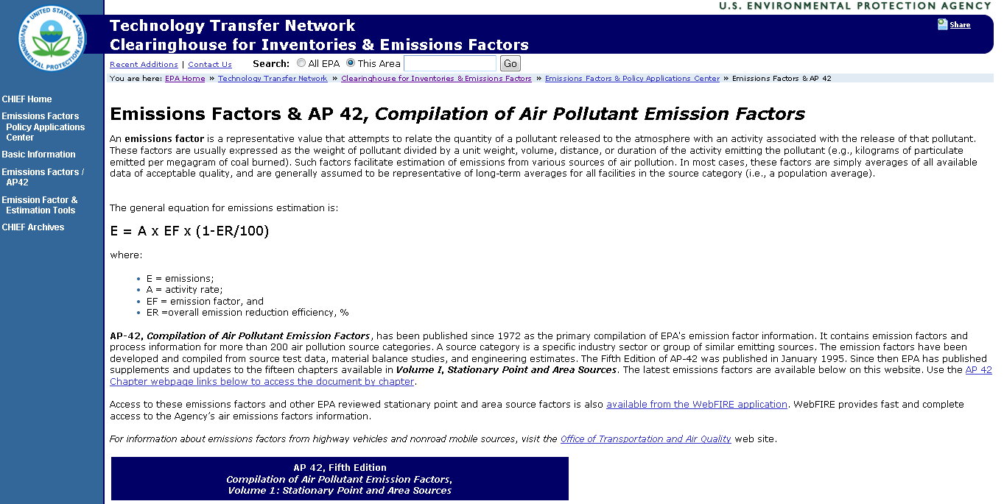
U.S. EPA provides documentation for developing emission inventories

Slide 34
Summary
Estimates of emissions are very important
Not all sources are equal
Timing and location matter
Lots of uncertainty associated with emission estimates

