Slide 1
The Atmospheric Oxidation System:
Ox, HOx, NOx, etc.
Sasha Madronich and Gabi Pfister
National Center for Atmospheric Research
Boulder, Colorado USA
10 March 2011

Slide 2
Atmospheric Life Cycle
solar UV radiation
Products:
CO₂,H₂O, CO
O₃, H₂O₂, CH₂O
H₂SO₄, HNO₃
SOA
photo-oxidation
formation of intermediates
transport
Emissions:
VOCs, NOx, SO₂
dry and wet
deposition
Increasing solubility

Slide 3
Energetics of Oxygen in the Atmosphere
ΔH_{f} (298K)
kcal mol⁻¹
Excited atoms O*(¹D) 104.9
Ground state atoms O (³P) 59.6
Ozone O₃ 34.1
Normal molecules O₂ 0
Increasing
stability

Slide 4
Atmospheric Oxygen Thermodynamic vs. Actual
O₃
O
O*

Slide 5
Photochemistry
Thermodynamics alone cannot explain atmospheric amounts of O₃, O, O*
Need
energy input, e.g.
O₂ + hν → O + O (λ < 240 nm)
chemical reactions, e.g.
O + O₂ (+ M) → O₃ (+ M)
= Photochemistry

Slide 6
Stratospheric Ozone Chemistry
The Only Production: O₂ + hν (λ < 242 nm) → O + O
Chapman 1930 O + O₂ + M → O₃ + M
Several Destruction Reactions:
Pure oxygen chemistry: O₃ + hν (λ < 800 nm) → O + O₂
Chapman 1930 O + O₃ → 2 O₂
Catalytic Cycles:
Odd hydrogen (HOx = OH + HO₂) O₃ + OH → O₂ + HO₂
Bates and Nicolet 1950 O + HO₂ → O₂ + OH
O₃ + HO₂ → 2 O₂ + OH
Odd nitrogen (NOx = NO + NO₂) O₃ + NO → O₂ + NO₂
Crutzen 1970 O + NO₂ → O₂ + NO
Halogens (Cl, Br) O₃ + Cl → O₂ + ClO
Rowland and Molina 1974 O + ClO → O₂ + Cl

Slide 7
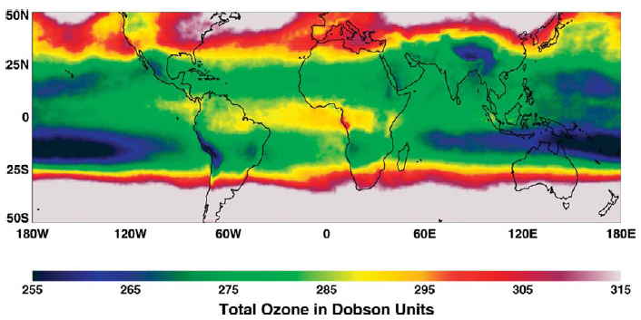
Total O₃ Column
Fishman et al., 2008

Slide 8
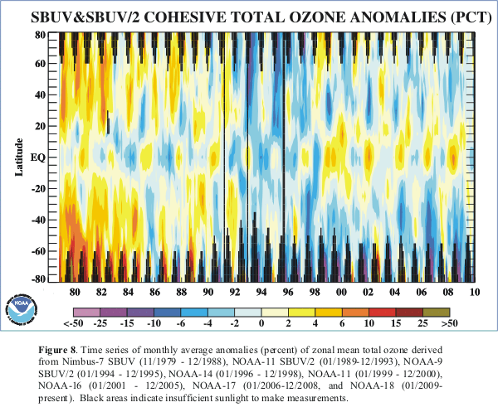
COLUMN OZONE TRENDS, %
http://www.cpc.ncep.noaa.gov/products/stratosphere/winter_bulletins/sh_09

Slide 9
Oxygen Species
UNEP 2002

Slide 10
Tropospheric O₃
TOMS-OMI, Oct 2007
S. Chandra and J. Ziemke (NASA GSFC)

Slide 11
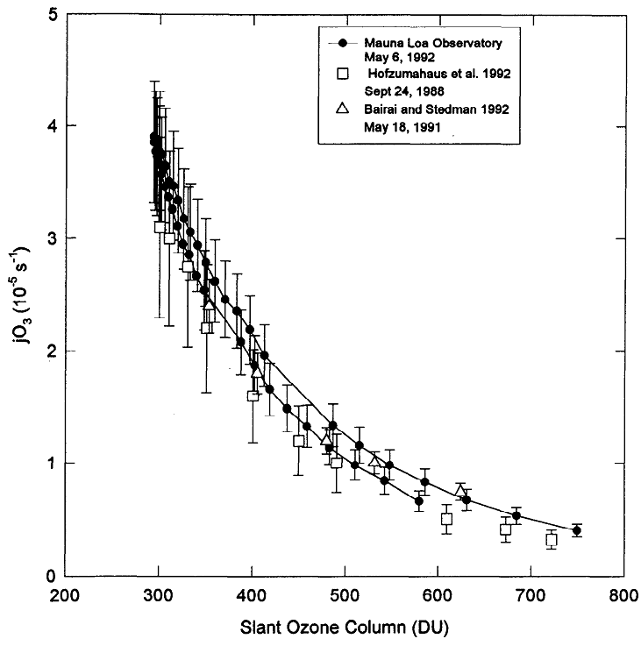
Tropospheric OH Source
O₃ + hv → O(¹D) + O₂
O(¹D) + N₂ → O(³P) + N₂
O(¹D) + O₂ → O(³P) + O₂
O(¹D) + H₂O → OH + OH
j(effective) ~ 10% of jO₃
Shetter et al., 1996

Slide 12
Tropospheric Ozone Formation - How?
Laboratory studies show that O₃ is made almost exclusively by the reaction:
O₂ + O + M → O₃ + M
But no tropospheric UV-C radiation to break O₂
O₂ + hν (λ < 242 nm) → O + O
Haagen-Smit(1950s) - Los Angeles smog:
Urban ozone (O₃) is generated when air containing hydrocarbons and nitrogen oxides (NOx = NO + NO₂) is exposed to tropospheric UV radiation
Notes:
This tells you something complicated is going on

Slide 13
The Nitrogen Family
N nitrogen atoms – negligible at room temperature T
N₂ molecular nitrogen
Nitrogen oxides : NOx ≡ NO + NO₂
NO nitric oxide is 90-95% of direct emissions
NO₂ nitrogen dioxide is 5-10% of direct emissions, but
more is made from NO + oxidants in the atmosphere
Zeldovich mechanism at high T (flames, engines, lightning):
O₂ + heat → O + O
O + N₂ → N + NO
N + O₂ → O + NO
(NO is the cross-product of scrambling N₂ and O₂ at high T)

Slide 14
heat, light
H₂O, CO₂
fragments
soot
NO
black body radiation
from soot (~1700 K)
N + O₂ → O + NO
O + N₂ → N + NO
O₂ + heat → O + O
fragments
soot
CO₂+H₂O+heat
HC + O₂ → partly oxidized fragments
Hydrocarbon Oxidation
O₂ entrainment
vaporizer
hydrocarbon
reservoir

Slide 15
(some other nitrogen species)
NO₃ nitrate radical
N₂O₅ dinitrogen tetroxide
HONO nitrous acid
HONO₂ nitric acid
CH₃ONO₂ methyl nitrate
N₂O nitrous oxide (laughing gas)
NH₃ ammonia
NH₂CH₃ methyl amine

Slide 16
Tropospheric O₃ Formation - 2
NO₂ photo-dissociation is the source of O atoms that make tropospheric O₃
NO₂ + hν (λ < 420 nm) → NO + O
O + O₂ + M → O₃ + M
_____________________________________________
Net: NO₂ + hν + O₂ → NO + O₃

Slide 17
PHOTODISSOCIATION COEFFICIENTS
J (s⁻¹) = ∫_{λ} F(λ) σ(λ) φ(λ) dλ
F(λ) = spectral actinic flux, quanta cm⁻² s⁻¹ nm⁻¹
∝ probability of photon near molecule.
σ(λ) = absorption cross section, cm² molec⁻¹
∝ probability that photon is absorbed.
φ(λ) = photodissociation quantum yield, molec quanta⁻¹
∝ probability that absorbed photon causes dissociation.

Slide 18
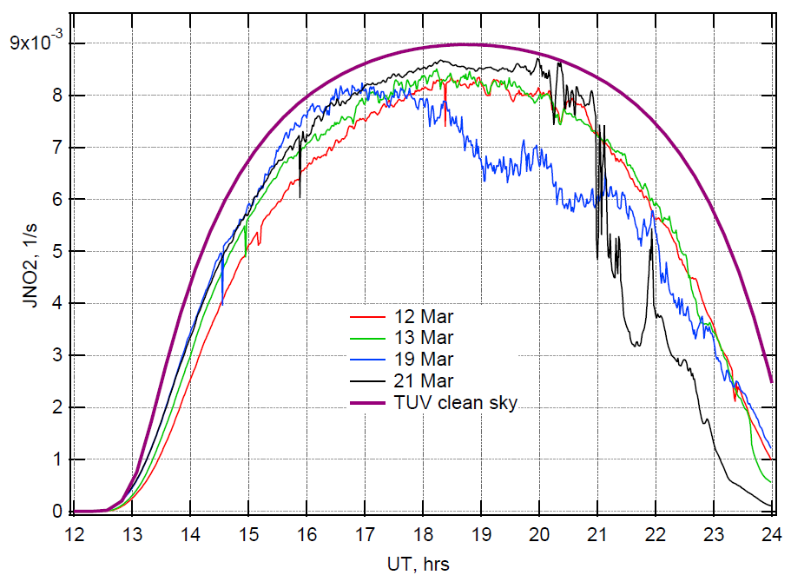
NO₂ + hν (λ < 420 nm) → NO + O
Mexico City, surface, March 2006

Slide 19
Tropospheric O₃ Formation - 3
NO₂ photo-dissociation makes some O₃, but not enough. Two problems:
Usually O₃ ~ 20 - 500 ppb >> NO₂ ~ 1 – 10 ppb
Reversal by the reaction:
NO + O₃ → NO₂ + O₂

Slide 20
Tropospheric O₃ Formation - 4
Initiation by UV radiation (Levy, 1970):
O₃ + hν (λ < 330 nm) → O*(¹D) + O₂
O*(¹D) + H₂O → ⋅OH + ⋅OH
Hydrocarbon consumption (oxygen entry point):
⋅OH + RH → R⋅ + H₂O
R⋅ + O₂ + M → ROO⋅ + M
Single-bonded oxygen transferred to NOx:
ROO⋅ + NO → RO⋅ + NO₂
NOx gives up oxygen atoms (as before):
NO₂ + hν (λ < 420 nm) → NO + O
O + O₂ + M → O₃ + M

Slide 21
Tropospheric O₃ Formation - 5
Propagation
RO⋅ + O₂ → R’CO + HOO⋅
HOO⋅ + NO → ⋅OH + NO₂
every NO → NO₂ conversion makes O₃
except NO + O₃ → NO₂ + O₂
Termination
⋅OH + NO₂ + M → HNO₃ + M
HOO⋅ + HOO⋅ + M → H₂O₂ + M
HOO⋅ + O₃ → ⋅OH + 2 O₂

Slide 22
Summary of Key Steps In Tropospheric O₃ Formation
Initiation by photo-dissociation
O₃ + hν + H₂O → 2 ⋅OH + O₂
Oxidation of hydrocarbons
⋅OH + RH + O₂ + M → ROO⋅ + H₂O + M
NO → NO₂ conversions
ROO⋅ + NO → RO⋅ + NO₂
O₃ + NO → NO₂ + O₂
Actual O₃ formation
NO₂ + hν + O₂ → O₃ + NO
Propagation
RO⋅ + O₂ → HOO⋅ + R’CO
HOO⋅ + NO → ⋅OH + NO₂
Termination
⋅OH + NO₂ + M → HNO₃ + M
HOO⋅ + HOO⋅ + M → H₂O₂ + O₂ + M
HOO⋅ + O₃ → ⋅OH + 2 O₂
An aside:
How do you know which reactions can happen, and which ones cannot?
Myth:
Obvious to chemists
Truth:
- Not obvious at all
- Quantum theory pretty good only for H + H₂ → H₂ + H
Most knowledge is semi-empirical, from lab experiments and from statistical thermodynamics

Slide 23
Ox ≡ NO₂ + O₃
ROx ≡ OH + HOO + RO + ROO
NOx ≡ NO + NO₂
The 1-slide Mechanism
ΔOx ΔROx ΔNOx
_______________________________________
Initiation by photo-oxidation
O₃ + hν + H₂O → 2 ⋅OH + O₂ -1 +2 na
⋅OH + RH + O₂ + M → ROO⋅ + H₂O + M 0 0 na
Partitioning by NOx
ROO⋅ + NO → RO⋅ + NO₂ +1 0 0
NO₂ + hν + O₂ → O₃ + NO 0 na 0
NO + O₃ → NO₂ + O₂ 0 na 0
Propagation
RO⋅ + O₂ → HOO⋅ + R’CO 0 0 na
HOO⋅ + NO → ⋅OH + NO₂ +1 0 0
Termination
⋅OH + NO₂ + M → HNO₃ + M -1 -1 -1
HOO⋅ + HOO⋅ + M → H₂O₂ + O₂ + M 0 -2 na
HOO⋅ + O₃ → ⋅OH + 2 O₂ -1 -1 na

Slide 24
Oy ≡ ROO + HOO + NO₂ + O₃
ROx ≡ OH + HOO + RO + ROO
NOx ≡ NO + NO₂
The 1-slide Mechanism
ΔOy ΔROx ΔNOx
_______________________________________
Initiation by photo-oxidation
O₃ + hν + H₂O → 2 ⋅OH + O₂ -1 +2 na
⋅OH + RH + O₂ + M → ROO⋅ + H₂O + M +1 0 na
Partitioning by NOx
ROO⋅ + NO → RO⋅ + NO₂ 0 0 0
NO₂ + hν + O₂ → O₃ + NO 0 na 0
NO + O₃ → NO₂ + O₂ 0 na 0
Propagation
RO⋅ + O₂ → HOO⋅ + R’CO +1 0 na
HOO⋅ + NO → ⋅OH + NO₂ 0 0 0
Termination
⋅OH + NO₂ + M → HNO₃ + M -1 -1 -1
HOO⋅ + HOO⋅ + M → H₂O₂ + O₂ + M -2 -2 na
HOO⋅ + O₃ → ⋅OH + 2 O₂ -2 -1 na

Slide 25
Global Hydrocarbon Emissions Tg C yr⁻¹
 | Isoprene | Terpenes | C₂H₆ | C₃H₈ | C₄H₁₀ | C₂H₄ | C₃H₆ | C₂H₂ | Benzene | Toluene
Fossil fuel | - | - | 4.8 | 4.9 | 8.3 | 8.6 | 8.6 | 2.3 | 4.6 | 13.7
Biomass burning | - | - | 5.6 | 3.3 | 1.7 | 8.6 | 4.3 | 1.8 | 2.8 | 1.8
Vegetation | 503 | 123 | 4.0 | 4.1 | 2.5 | 8.6 | 8.6 | - | - | -
Oceans | - | - | 0.8 | 1.1 | - | 1.6 | 1.4 | - | - | -
TOTAL | 503 | 123 | 15.2 | 13.4 | 12.5 | 27.4 | 22.9 | 4.1 | 7.4 | 15.5
CH₄ ~ 500 – 600 Tg CH₄ yr⁻¹ [IPCC, 2001]
Ehhalt, 1999

Slide 26
Tropospheric Chemical Mechanisms
Heuristic:
~10 reactions [here, or Seinfeld and Pandis, 1997]
Typical 3D model used for air quality:
100 - 300 reactions
CB-IV, CB-V [Gery, 1989]
RADM, RACM [Stockwell, 1990; 1997]
SAPRC99 [Carter, 2000]
Typical 0D (box) models used for sensitivity studies:
3,000 - 10,000 reactions
NCAR Master Mechanism [Madronich and Calvert, 1990]
Leeds Master Chemical Mechanism [Jenkin et al. 1997]
Fully explicit (computer-aided) mechanisms:
10⁶ - 10⁷ reactions
GECKO-A [Aumont et al. 2005]

Slide 27
Atmospheric VOC’s: Hydrocarbons - 1
Alkanes
CH₄
CH₃CH₃
CH₃CH₂CH₃
C₄H₁₀ (2 isomers)
C₅H₁₂ (3 isomers)
C₆H₁₄ (5 isomers)
C₇H₁₆ (9 isomers)
C₈H₁₈ (18 isomers)
….
methane
ethane
propane
butane
pentane
hexane
heptane
octane
….

Slide 28
Atmospheric VOC’s: Hydrocarbons - 2
Alkenes
CH₂=CH₂
CH₂=CHCH₃
…
CH₂=C(CH₃)CH=CH₃
Aromatics
C₆H₆
C₆H₅CH₃
C₆H₅(CH₃)₂ (3 isomers)
…
Terpenes
C₁₀H₁₆
ethene (ethylene)
propene (propylene)
…
2-methyl 1,3 butadiene (isoprene)
Benzene
Toluene
Xylenes
…
α-pinine, β-pinine
…

Slide 29
Atmospheric VOC’s: Substituted Hydrocarbons
Alcohols, -OH
methanol, CH₃OH
ethanol, CH₃CH₂OH
Aldehydes, -CHO
formaldehyde,CH₂O
acetaldehyde, CH₃CHO
Ketones, -CO-
acetone, CH₃COCH₃
MEK, CH₃COCH₂CH₃
Carboxylic acids, -CO(OH)
formic, HCO(OH)
acetic, CH₃CO(OOH)
Organic hydroperoxides, -OOH
methyl hydroperoxide, CH₃(OOH)
Organic peroxy acids, -CO(OOH)
peracetic, CH₃CO(OOH)
Organic nitrates, -ONO₂
methyl nitrate, CH₃(ONO₂)
Ethyl nitrate, CH₃CH₂(ONO₂)
Peroxy nitrates, -OONO₂
methyl peroxy nitrate, CH₃(OONO₂)
Acyl peroxy nitrates, -CO(OONO₂)
PAN, CH₃CO(OONO₂)

Slide 30
General Hydrocarbon Reaction Patterns
Short-chain compounds tend to have unique behavior, and must be considered individually.
Longer-chain compounds are quite alike within each family (e.g. all aldehydes). Kinetics and mechanisms can be adjusted for chain length and substitutions (structure-activity relations).

Slide 31
OH + Hydrocarbon Reactions
Abstraction of H
OH + CH₃CH₃ → CH₃CH₂⋅
…followed immediately by
CH₃CH₂⋅ + O₂ + M → CH₃CH₂OO⋅ + M
Addition to double bonds
OH + CH₂=CH₂ → CH₂(OH)CH₂⋅
…followed immediately by
CH₂(OH)CH₂⋅+ O₂ + M → CH₃(OH)CH₂OO⋅ + M

Slide 32
Atmospheric Organic Radicals
Alkyl (carbon-centered)
⋅CH₃ methyl
⋅CH₂CH₃ ethyl
⋅CH₂CH₂CH₃ propyl
Peroxy, -OO⋅
CH₃OO⋅ methyl peroxy
CH₃CH₂OO⋅ ethyl peroxy
Alkoxy, -O⋅
CH₃O⋅ methoxy
CH₃CH₂O⋅ ethoxy
Acyl, CO(OO⋅)
CH₃CO(OO⋅) acetyl
Criegee, ⋅C(OO⋅)
⋅CH₂OO⋅ from O₃ + C₂H₄
CH₃⋅CHOO⋅ from O₃ + C₃H₆

Slide 33
O₃ + Hydrocarbon Reactions
Ozone addition across double bond
O₃ + CH₂=CH₂ → CH₂ – CH₂ → CH₂O + (⋅CH₂OO⋅)*
Fate of excited Criegee diradical:
(⋅CH₂OO⋅)* → CO + H₂O
→ CO₂ + H₂
→ CO₂ + 2 H
→ …
+ M → ⋅CH₂OO⋅ (stabilized Criegee diradical)
⋅CH₂OO⋅ + (H₂O, NO, NO₂, SO₂) → Products
O
O
O

Slide 34
NO₃ + VOC Reactions
H atom abstraction:
CH₃CHO + NO₃ → CH₃CO⋅ + HNO₃
CH₃CO⋅ + O₂ + M → CH₃CO(OO⋅) + M
Addition to double bond:
CH₂=CH₂ + NO₃ + M → CH₂(ONO₂)CH₂⋅ + M
CH₂(ONO₂)CH₂⋅ + O₂ + M → CH₂(ONO₂)CH₂(OO⋅) + M

Slide 35
Peroxy Radical Reactions - 1
with NO
ROO⋅ + NO → RO⋅ + NO₂
ROO⋅ + NO + M→ RONO₂ + M
with NO₂
ROO⋅ + NO₂ + M → ROONO₂ + M
RCO(OO⋅) + NO₂ + M → RCO(OONO₂) + M

Slide 36
Peroxy Radical Reactions - 2
with HO₂
ROO⋅ + HOO⋅ → ROOH + O₂
RCO(OO⋅) + HOO⋅ → RCO(OOH) + O₂
with other organic peroxy radicals, e.g.
CH₃CH₂OO⋅ + CH₃OO⋅ →
radical channel → CH₃CH₂O⋅ + CH₃O⋅ + O₂
molecular channel 1 → CH₃CH₂OH + CH₂O + O₂
molecular channel 2 → CH₃CHO + CH₃OH + O₂

Slide 37
Alkoxy Radical Reactions
with O₂, e.g.
CH₃CH₂O⋅ + O₂ → CH₃CHO + HOO⋅
CH₃CH(O⋅)CH₃ + O₂ → CH₃COCH₃ + HOO⋅
thermal decomposition, e.g.
CH₂CH(O⋅)CH₂OH + M → CH₃CHO + ⋅CH₂OH + M
isomerization, e.g.
CH₃CH(O⋅)CH₂CH₂CH₂CH₃ →
→ CH₃CH(OH)CH₂CH₂ ⋅CHCH₃

Slide 38
Reactions of Partly Oxidized Species
OH, O₃, and NO₃ reactions as with precursor hydrocarbons
photolysis important for
aldehydes
ketones
peroxides
alkyl nitrates
but not for alcohols or carboxylic acids
thermal decomposition for peroxy nitrates

Slide 39
Generalized Oxidation
Sequence of Hydrocarbons
RH
OH, O₃, NO₃
R⋅
O₂
NO
HO₂
ROO⋅
OH
NO
RONO₂
hν
RO⋅
hν
ROOH
O₂, heat
OH
OH
R’CHO
OH, O₃, NO₃
…
CO₂ + H₂O

Slide 40
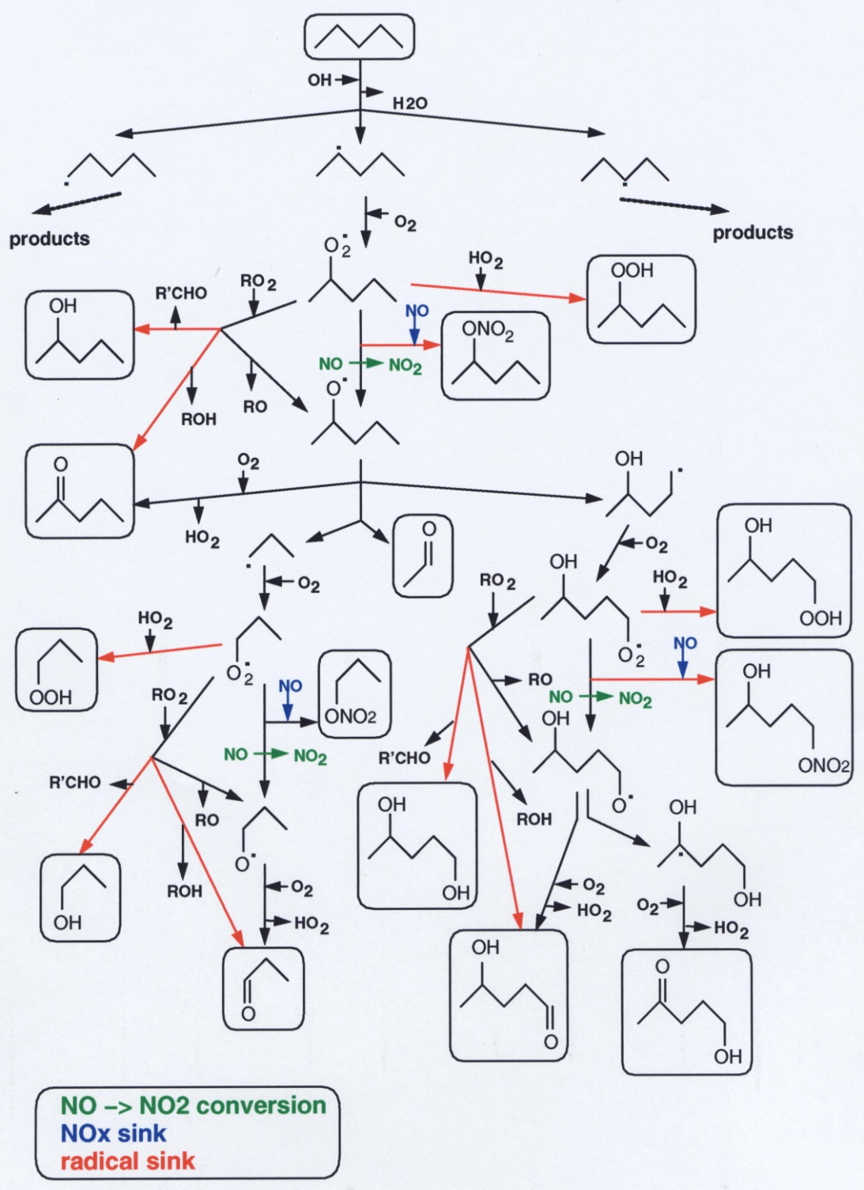
Simplified Mechanism for Pentane (C₅H₁₂)
Multiple NO→NO₂ conversions
produce O₃
Organic nitrates allow long-range
transport of NOx
Radical sinks:
Some are temporary, producing
HOx later
Some have low vapor pressures,
can make organic aerosols

Slide 41
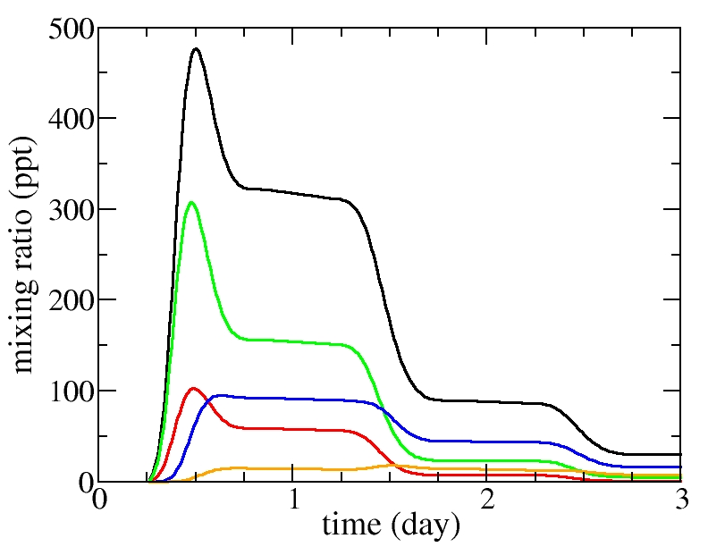
Time Integration with Two-step Iterative Solver
Products of n-heptane oxidation (high NOx case)
All C7 species
2 functions
3 functions
1 function
4 functions

Slide 42
2 functional groups : typical species
O
OH
O
O
O
ONO₂
All C7 species
ONO₂
O
O
ONO₂
2 functions
OH
ONO₂
3 functions
1 function
4 functions

Slide 43
3 functional groups : typical species
O
OH
O
ONO₂
O
ONO₂
O
O
O
O
O
All C7 species
ONO₂
OH
O
ONO₂
O
O
2 functions
ONO₂
ONO₂
3 functions
1 function
4 functions

Slide 44
4 functional groups : typical species
O
O
ONO₂
O
ONO₂
ONO₂
OH
OH
O
ONO₂
O
O
All C7 species
ONO₂
O
OH
ONO₂
O
O
O
ONO₂
O
ONO₂
2 functions
ONO₂
OH
3 functions
1 function
4 functions

Slide 45
Growth of Mechanisms
Aumont et al., 2007

Slide 46
Ox ≡ NO₂ + O₃
ROx ≡ OH + HOO + RO + ROO
NOx ≡ NO + NO₂
The 1-slide Mechanism
ΔOx ΔROx ΔNOx
_______________________________________
Initiation by photo-oxidation
O₃ + hν + H₂O → 2 ⋅OH + O₂ -1 +2 na
⋅OH + RH + O₂ + M → ROO⋅ + H₂O + M 0 0 na
Partitioning by NOx
ROO⋅ + NO → RO⋅ + NO₂ +1 0 0
NO₂ + hν + O₂ → O₃ + NO 0 na 0
NO + O₃ → NO₂ + O₂ 0 na 0
Propagation
RO⋅ + O₂ → HOO⋅ + R’CO 0 0 na
HOO⋅ + NO → ⋅OH + NO₂ +1 0 0
Termination
⋅OH + NO₂ + M → HNO₃ + M -1 -1 -1
HOO⋅ + HOO⋅ + M → H₂O₂ + O₂ + M 0 -2 na
HOO⋅ + O₃ → ⋅OH + 2 O₂ -1 -1 na

Slide 47
Oy ≡ HOO + NO₂ + O₃
ROx ≡ OH + HOO + RO + ROO
NOx ≡ NO + NO₂
The Half-slide Mechanism
ΔOy ΔROx ΔNOx
_______________________________________
Initiation by photo-oxidation
O₃ + hν + H₂O → 2 ⋅OH + O₂ -1 +2 na
⋅OH + RH + O₂ + M → HOO⋅ + H₂O + M +1 0 na
Partitioning by NOx
HOO⋅ + NO → ⋅OH+ NO₂ 0 0 0
NO₂ + hν + O₂ → O₃ + NO 0 na 0
NO + O₃ → NO₂ + O₂ 0 na 0
Termination
⋅OH + NO₂ + M → HNO₃ + M -1 -1 -1
HOO⋅ + HOO⋅ + M → H₂O₂ + O₂ + M -2 -2 na

Slide 48
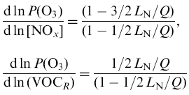
NOx-VOC Regimes
VOC-limited
NOx-limited
NOx-inhibited
Low NOx
High NOx

Slide 50
DIURNAL AND WEEKLY VARIATIONS Surface network in Mexico City
Stephens et al., 2008

Slide 52
Mexico City’s O₃ Production Is VOC-limited, NOx-inhibited
WRF-Chem model
--- sensitivity studies
● observations
3VOC
3NOx
3VOC
3NOx
Tie et al., 2007

Slide 53
Aerosol Yield is a function of VOC/NOx
Camredon et al., 2007

Slide 54
California EPA, 2004

Slide 55
Health Impacts of Air Quality
Largely due to carbon-containing particles and O₃
WHO estimates for 2002:
World: 865,000 deaths per year
1.0 DALY* /1000 capita per year
U.S.: 41,200 deaths per year
0.8 DALY /1000 capita per year
* DALY = Disability-Adjusted Lost Years
WHO, 2007

Slide 56
Local Ozone
Air Quality in CA has improved over the past years, but
ozone values exceeding health standards are still frequent.
site categories: all urban suburban rural
Frequency of hourly surface O₃ for 1994-2008 (U.S. EPA Surface Monitoring; AQS Datamart)

Slide 57
Local Ozone - and Background
Air Quality has improved over the past years, but
ozone values exceeding health standards are still frequent.
As local sources are reduced and health standards get tighter, the influence of "background" gains more importance.
0.76 ± 0.29 ppbv/year
O. Cooper et al., Nature, 2009
“Increasing springtime ozone mixing ratios in the free troposphere over western North America”
Notes:
We want to look more closely into what this "bg" is. It involves pollution transport

Slide 58
WRF-Chem Regional O₃ Prediction
Observed daily 1-h maximum O3 for all EPA AIRNOW surface stations in the model domain, 21 July - 4 August 2002.
Grell et al., 2005

Slide 59
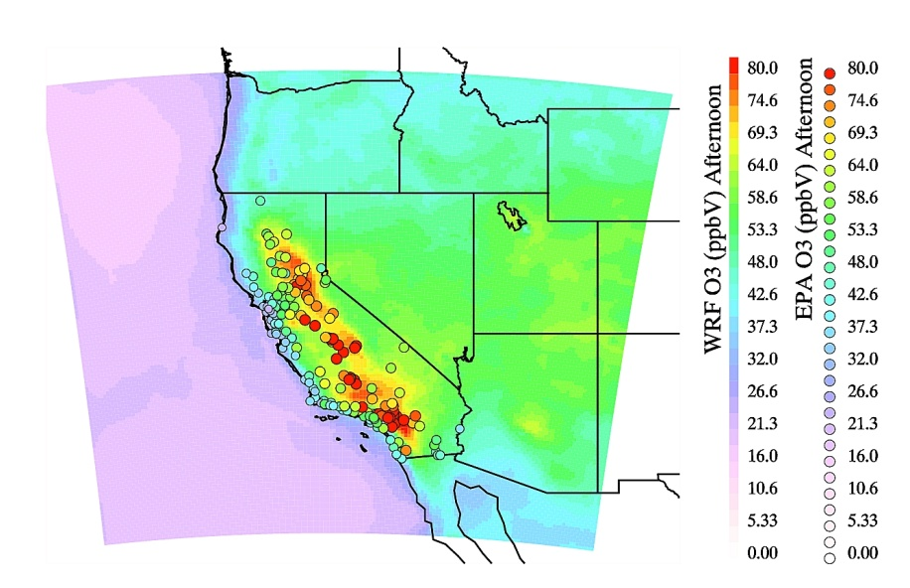
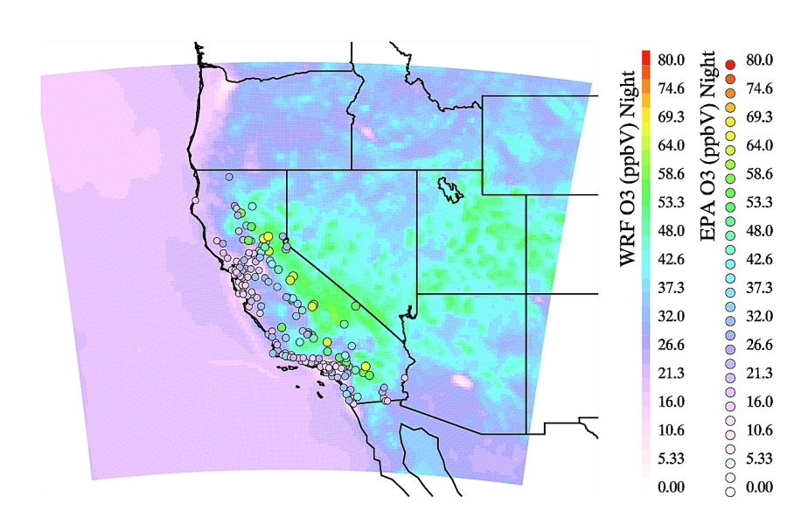
Surface Ozone: Monitoring and Modeling
Average for Local Afternoon
Average for Nighttime
Surface Ozone 14 June – 15 July 2008

Slide 60
FUTURE TROPOSPHERIC O₃: MODELS DISAGREE
IPCC 2001

Slide 61
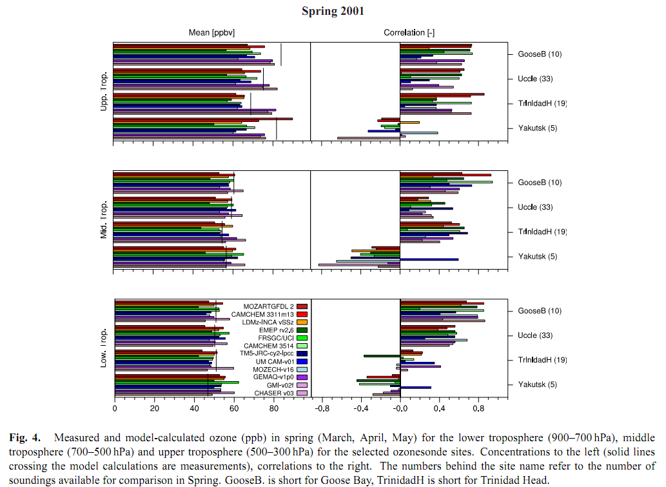
Advances in modeling
Jonson et al., 2010

Slide 62
Global Oxidation (self-cleaning) Capacity
Solar UV radiation
Oxidation, e.g.:
CH₄ + OH → …→ CO₂ + H₂O
Insoluble → Soluble
Carboxylic acids
H₂SO₄, SO₄⁼
Halocarbons
Emissions
Deposition
(dry, wet)
HNO₃, NO₃⁻
CH₄
C_{m}H_{n}
NO
NO₂
HCl, Cl⁻
CO
SO₂

Slide 63
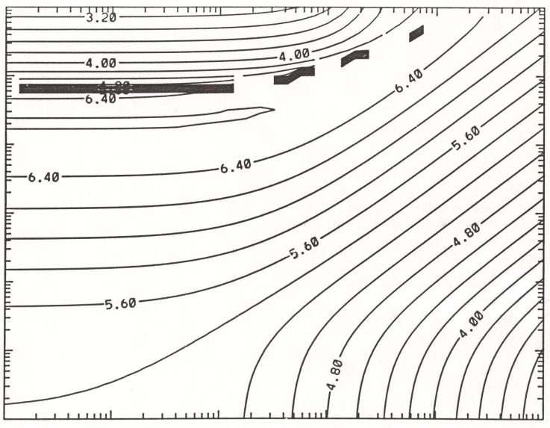
TROPOSPHERIC OXIDIZING (SELF-CLEANING) CAPACITY Log₁₀ [OH] - Global Box Model Different OH regimes
F_{O3}=5e4 cm⁻³ s⁻¹, F_{CO}=1e5 cm⁻³ s⁻¹
10⁶
10⁵
future?
10⁴
~current
pre-
industrial
10³
F_{NO}, cm⁻³ s⁻¹
10²
10¹
10⁰
10²
10³
10⁴
10⁵
10⁶
10⁷
F_{CH4}, cm⁻³ s⁻¹
Madronich and Hess, 1993

Slide 64
Ox-HOx-NOx-CO Processing
O₃
HO₂
NO₂
OH
O₃+hν
OH+CO
HO₂+NO
NO₂+hν
OH
NO
HO₂
HO₂
NO₂
NO
O₃
HO₂+HO₂
HO₂+HO₂
OH
O₃+NO
OH
NO₂
NO₂
NO₂
OH
NO₂
OH
OH+NO₂
OH+NO₂

